Slide 1
Broadband Breakthrough: Infrastructure Planning for Rural Farming Communities
September 15, 2023

Slide 2
Welcome -Janie Dunning, Show Me Broadband Role of Project Partners/Background -Adrianne Furniss, Benton Institute for Broadband & Society Program overview -Bill Coleman, Benton Institute Adjourn
Today’s Agenda

Slide 3
Role of Project Partners
Adrianne Furniss
Benton Institute for Broadband & Society

Slide 4
Funding for the Missouri Broadband Breakthrough program is made possible by the Ford Foundation

Slide 5
Sponsoring Partners Project Goals
ENGAGE AGRICULTURAL COMMUNITY LEADERSHIP IN SUPPORT OF RURAL COMMUNITY BROADBAND DEVELOPMENT
DELIVER ADVANCED SURVEY, SPEED TEST AND MAPPING TOOLS TO RURAL BROADBAND TEAMS
SHARE AGRICULTURAL ECONOMIC COST-BENEFIT ANALYSIS SUPPORTING RURAL BROADBAND DEPLOYMENT
CREATE AND DOCUMENT REPLICABLE BEST PRACTICES IN RURAL AGRICULTURAL COMMUNITIES

Slide 6
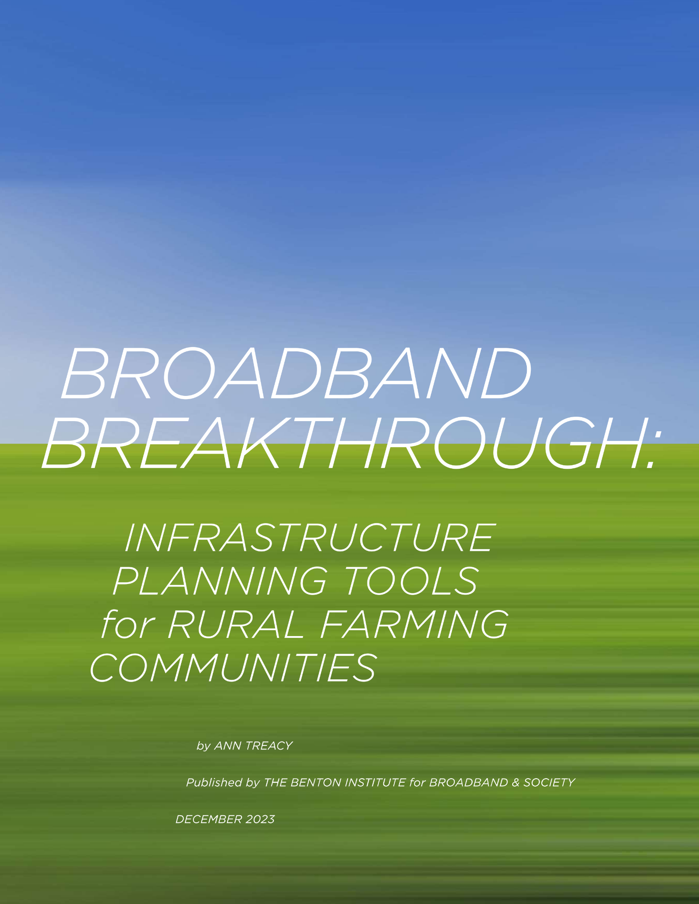
Background
December 2023 Benton Report — Broadband Breakthrough: Infrastructure Planning Tools for Rural Farming Communities
Report describes the journey of the first cohort of Broadband Breakthrough counties.
Two tools were developed by Illinois State University, through funding support from the Illinois Innovation Network:
Tool I: Provides quantitative value analysis of broadband’s positive impact on the farming economy, specifically on corn and soy production.
Tool II: Mapped vertical assets in Broadband Breakthrough counties that might help wireless broadband deployment.
A Wireless Research Center report helped rural communities assess the benefits and challenges of various modes of wireless broadband as a supplement to wired connectivity.

Slide 7
Program Overview
Bill Coleman
Benton Institute

Slide 8
Determine, pursue, and achieve the best possible broadband solution for your community.
Program Purpose

Slide 9
A guided, self-help, four-month broadband planning process empowering community teams meeting weekly and undertaking critical information gathering and strategy development activities.
Approach

Slide 10
Process Phases
Leadership Recruitment and Education
Information Gathering
Vision Development/Consensus Building
Opportunity Analysis
Reporting
Project Development

Slide 11
Leadership Recruitment and Education
Team Membership
Bigger team is better
Variety of knowledge and skills
Community connections
Core team and affiliates
Team Education
Shared learning experiences
Resource materials
Webinars – live and archived
Web resources
Tours
Active engagement in information gathering phase
Notes:
Who has got a great team? Why is it working?
What kind of shared learning have you done?

Slide 12
Information Gathering
Surveys
Community use surveys with ag-focused questions
Speed test data
Key customer focus groups - optional
Residents
Businesses
Anchor institutions
Agricultural sector
Community on-site tour week
Provider interviews
Existing providers
Prospective providers
Maps and GIS Tools
Missouri Broadband Maps
Our partners provide data sets provide an economic rationale for broadband investment using state broadband maps and USDA data; high point analyses
Speed test data
Grant eligibility mapping
New FCC maps (limited use)

Slide 13
Vision Development & Consensus Building
Take the time for hard conversations!
Understand the ramifications of each word in your vision statement.
Possible trade-offs require consideration

Slide 14
Opportunity Analysis
What are the best opportunities for provider partnerships?
Which funding strategies are most applicable to your community?
Are you prepared to be a good partner?
What is our Plan B?

Slide 15
Report to the Community
Share your vision and strategy early and often to build community consensus.
Identify community objections early.
Utilize public forums for community outreach
Regular county board meeting updates
Host broadband-focused meetings
Attend and seek input at other community meetings
Present findings and recommendations
Recruit additional champions on an ongoing basis

Slide 16
Project Development
FAST OR SLOW
COMPREHENSIVE OR PIECEMEAL
STRAIGHT-FORWARD OR REQUIRE NEW STRATEGIES AND MULTIPLE ATTEMPTS

Slide 17
Weekly Topics
Overview/Broadband 101/Broadband Drivers
Broadband Surveys
Broadband Mapping/Provider Interviews/Ag considerations in broadband deployment
Vision/Goals/Outcomes
Coalition Building/ Community Communications
Fiber Optic Overview/Middle-Mile Networks
Wireless Technologies Overview
Onsite Community Tours & Meetings
Ownership and Partnership Models
Feasibility Studies
Federal and State Financing
Other financing strategies
Local Planning Sessions
Community Presentations

Slide 18
Program Unique Value Adds
Active outreach to the local/regional ag industry
Active leadership by the local/regional ag industry
Unique mapping support, including economic and physical layers
In-depth information on fiber and wireless technology choices

Slide 19
Key Success Factors
Team
Recruit and maintain strong involvement
Start
Don’t overthink, focus on doing
Listen & Talk
Develop community consensus
Be Flexible
Adjust plans as you learn
Be Persistent
Community broadband may be a marathon

Slide 20
Key Contacts
Benton Institute
-Bill Coleman, bcoleman@Benton.org, 651-491-2551
-Reid Sharkey, reid@Benton.org, 703-400-2106

Slide 21
Q & A/Discussion

Slide 22
Closing Remarks
Adrianne Furniss, Benton Institute

