Slide 1
Broadband Opportunities Through Better Mapping
Missouri’s BEAD Challenge Process

Slide 2
BEAD: A Historic Opportunity
The Broadband Equity, Access, and Deployment program (BEAD) will bring $1.7 billion to the state of Missouri
Goal is to connect the roughly 200,000 locations in the state of Missouri without service or existing funding
Important Dates
March 25: Scheduled launch of the challenge process
Summer 2024: Applications for first round of funding
Fall 2024: Applications for second round of funding

Slide 3
Current Status
Our BEAD Volume I (covering location eligibility and the challenge process) has been approved
BEAD Volume II (covering our subgrantee selection process) is going through curing
Expect to see substantially more information about the challenge process this week and next
Guides and user support
Final publication of pre-challenge eligibility determinations

Slide 4
State Map and Challenge Portal
BROADBANDMAP.MO.GOV
Served: at or above 100/20 Mbps (fiber, cable, most licensed fixed wireless)
Underserved: at or above 25/3 Mbps AND
DSL Service at or above 100/20 Mbps
Cellular Fixed Wireless Service at or above 100/20 Mbps
Unserved: below 25/3 Mbps OR
Unlicensed Fixed Wireless at any speed
Satellite at any speed

Slide 5
Pre-Challenge Map Changes
Full implementation of approved “pre-challenge modifications”
Cellular Licensed fixed wireless >= 100/20 Mbps as underserved
DSL >= 100/20 Mbps as underserved
Service overturned in areas where a large number of successful challenges were filed through the FCC process
Search by municipality function

Slide 6
Information on the Map
Each address shows:
Providers using an eligible technology
Whether there is a funded project for the address
Summaries at different geographic levels
Polygons of funded projects

Slide 7
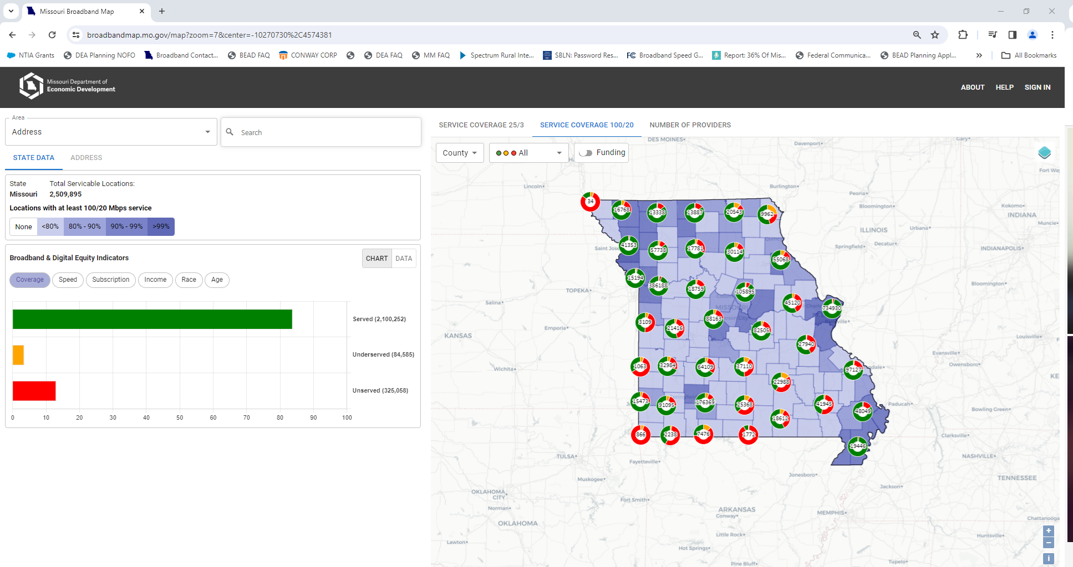

Slide 8
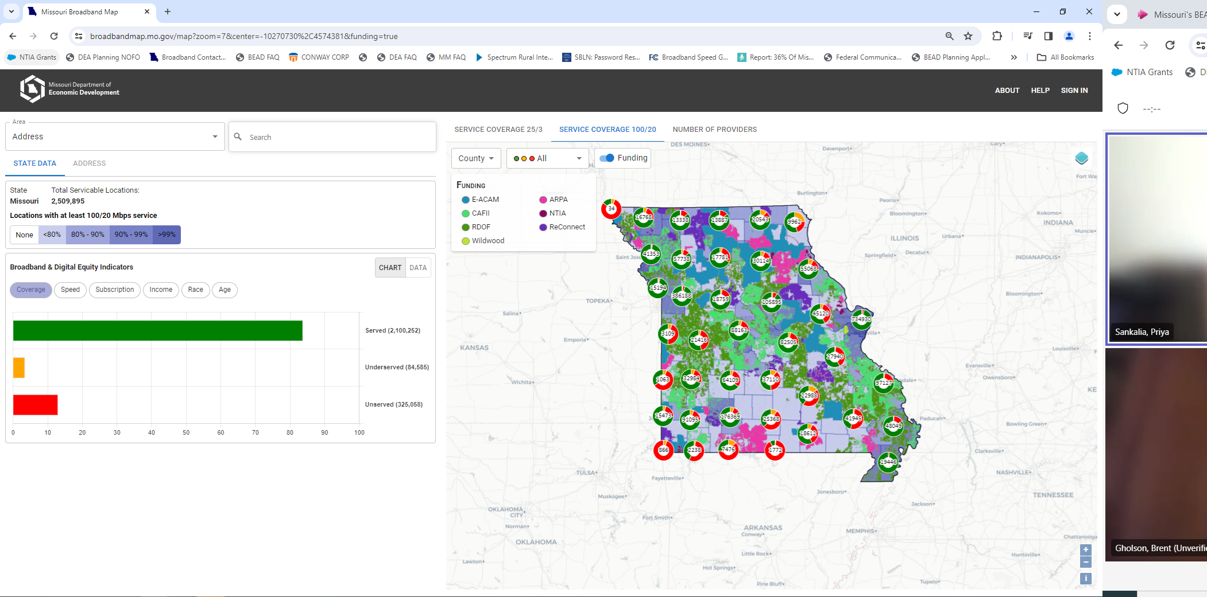

Slide 9
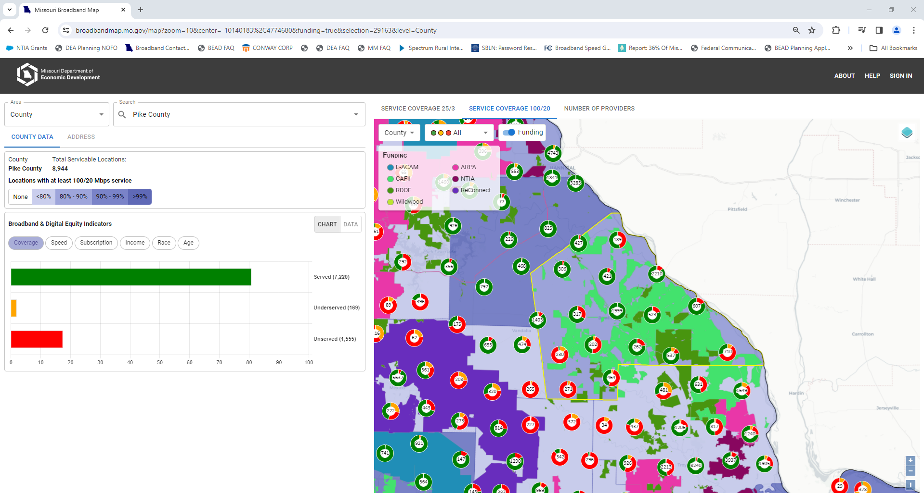

Slide 10
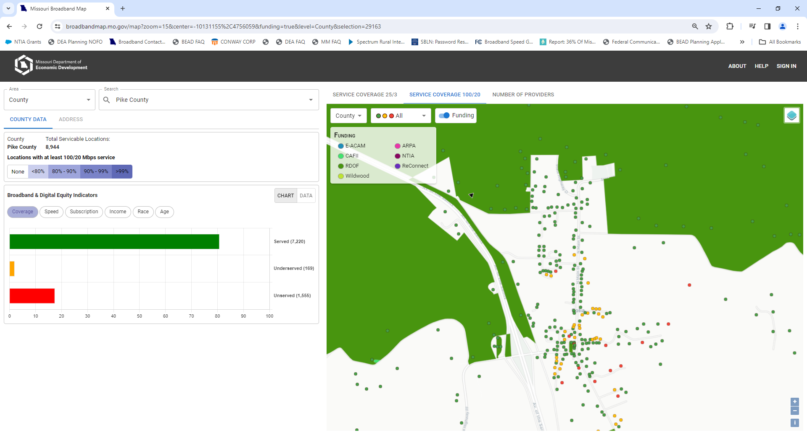

Slide 11
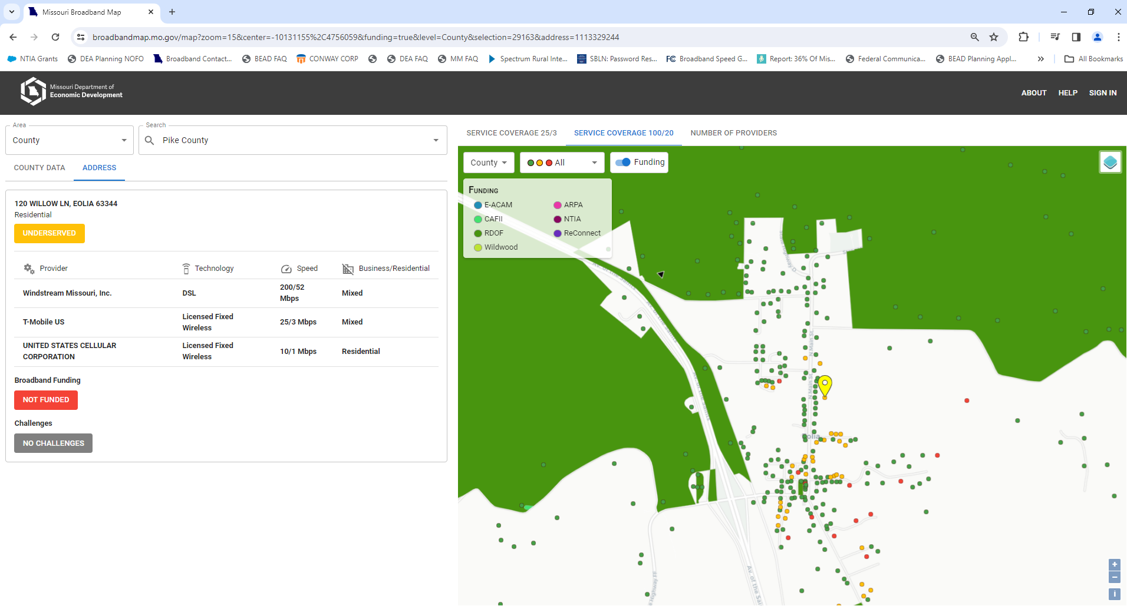

Slide 12
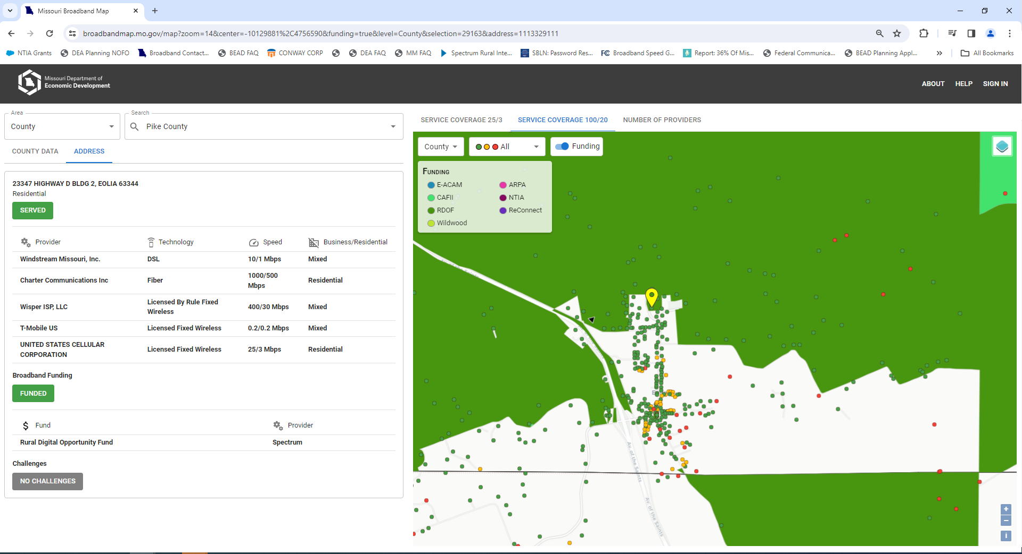

Slide 13
Challenges: Overview
Submitted through portal
Focus on cases that change eligibility: locations with incorrect reporting at 100/20 Mbps and no other service at 100/20 Mbps (or funded commitment)
Local governments, non-profits, and internet service providers are valid challengers and rebutters

Slide 14
Challenges: Broadband Availability
Broadband service reported on the map is not available
Infrastructure is not present
Provider denied a request for service
Provider required extraordinary installation fees (to cover the cost of extending their network)
Provider could not install within 10 days
Provider requires a site survey before allowing a location to subscribe
If evidence is valid and rebuttal is insufficient, location could become eligible for BEAD

Slide 15
Challenges: Speed and Latency
Broadband Service is available but cannot meet the speed tier reported (e.g. under 100/20 Mbps for a served location)
Tests can be taken through our portal
Must establish location subscribes in established speed tier
Three tests on three different days – our system will prompt follow-ups
If evidence is valid and rebuttal is insufficient, location could become eligible for BEAD

Slide 16
Challenges: Enforceable Commitment
Service will be provided through an enforceable commitment not captured on the map
Evidence: agreement between provider and funder
If evidence is valid and rebuttal is insufficient, location becomes ineligible for BEAD
“Not an enforceable commitment” challenge type requires evidence that a location is not subject to a commitment – not that the challenger believes the provider will not meet their commitment
Evidence: statement from provider with the commitment

Slide 17
Challenges: Planned Service
No funding commitment, but there will be service as of Dec. 31, 2024
Evidence: Permitting, construction plans, evidence of progress
Providers should file this challenge type for any location that is not reported on the current FCC map that will be on the FCC map when they report service for Dec. 31, 2024
If evidence is valid and rebuttal is insufficient, location becomes ineligible for BEAD

Slide 18
Challenges: Community Anchors
Can challenge on the ground that a location is an eligible community anchor institution (CAI). An eligible CAI meets two criteria:
No access to service of 1 Gbps/1 Gbps AND
Is a CAI by our definition
Can also challenge on the grounds that a location is not an eligible CAI:
Access to service of 1 Gbps/1 Gbps OR
Not a CAI by our definition

Slide 19
More on Community Anchors
Eligible for BEAD if they have no access to service at 1 Gbps/1 Gbps
Locations we have identified as CAIs appear as triangles on the broadband map
Red: Eligible CAI
Black: CAI with unknown service. Treated as eligible only if we receive a challenge a CAI challenge indicating speeds under 1 Gbps / 1 Gbps
CAI designation will matter most for CAIs that would be “served” by the standard BSL definition but do not have 1 Gbps/1 Gbps

Slide 20
Community Anchors
Only relevant in cases where service is between 100/20 Mbps and 1/1 Gbps
IIJA Defined
Schools
Libraries
Medical Providers
Public Safety Entities
Higher Education
Public Housing agencies
OBD “Community Support Organizations”
Senior Centers
Job Training Centers
Nutrition Centers
Local Government Buildings

Slide 21
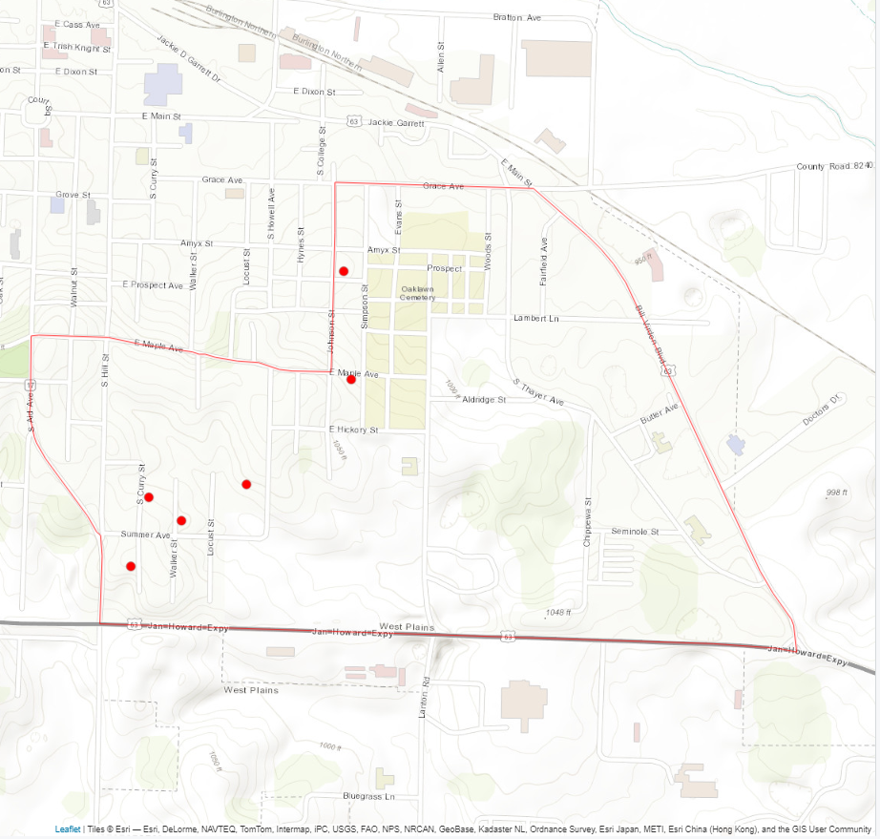
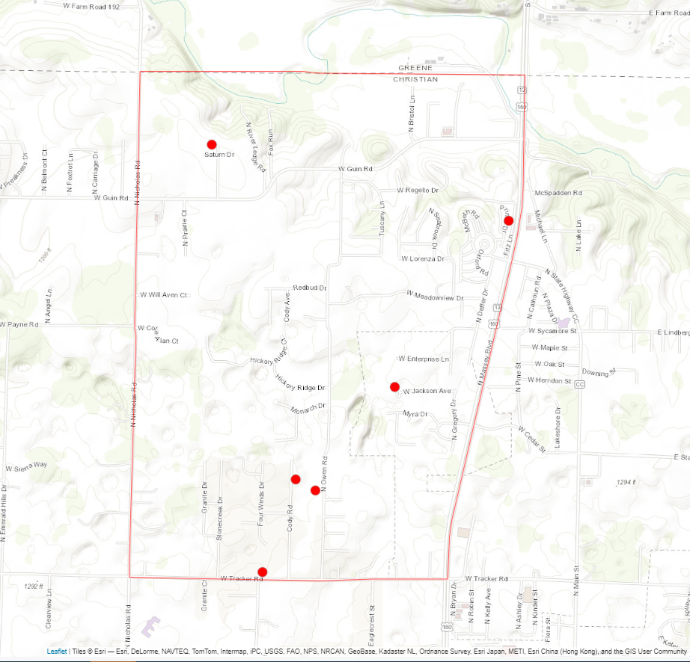
Challenges: Area
Challenges generally must be based on evidence specific to the address being challenged
To challenge larger areas, challengers can submit enough challenges to trigger an area challenge
6 challenges against the same provider using the same challenge type in a census block group
30 challenges in a tract, with at least one in every group
FCC challenges count toward this total

Slide 22
Challenges: Multi-Dwelling
Challenges to individual units in a building can trigger challenges to the whole building. For buildings with:
15 or fewer units, one unit triggers
16-24 units, two units trigger
25 or more units, three units trigger

Slide 23
Challenges: Public Data Submission
Members of the public are not eligible challengers, but they can can:
Submit evidence of broadband availability (analogous to FCC challenge process)
Take and submit speed tests
Evidence sufficient to substantiate challenges may be submitted as a challenge by the University of Missouri
OBD will be promoting this opportunity around the state

Slide 24
Rebuttals: from ISPs
For challenges against a specific ISP’s service, the ISP will be notified of challenges and asked to provide evidence that the challenge is not valid
Challenged providers will have thirty days to respond
Evidence depends on type of challenge – could be provider’s own speed test, evidence that they do offer service, etc.
OBD adjudicates. We have contracted for field verification for difficult cases

Slide 25
Rebuttals: ISPs, Non-profits, & Local Govs
For other challenge types OBD will post challenges publicly and allow any eligible challenger to rebut during the thirty day rebuttal window
Planned Service: would need to see evidence that the service will not available as of Dec. 31
Enforceable Commitment: Would need to see evidence that the provider has defaulted or cannot meet the commitment (for instance, because they went out of business
CAIs: Would need evidence that the location (a) does not have 1 Gbps/1 Gbps service, or (b) that the location does meet the CAI definition (or vice versa, if the challenge indicated it was a CAI)

Slide 26
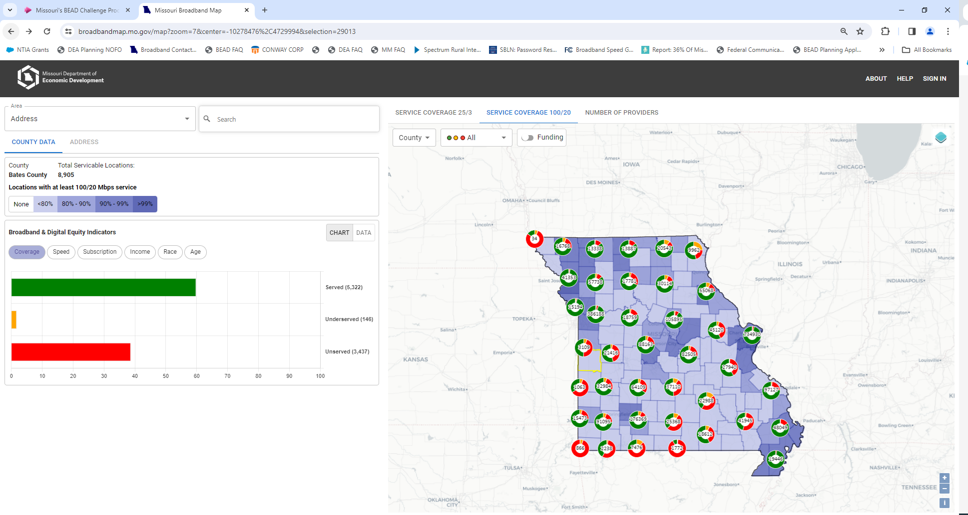

Slide 27
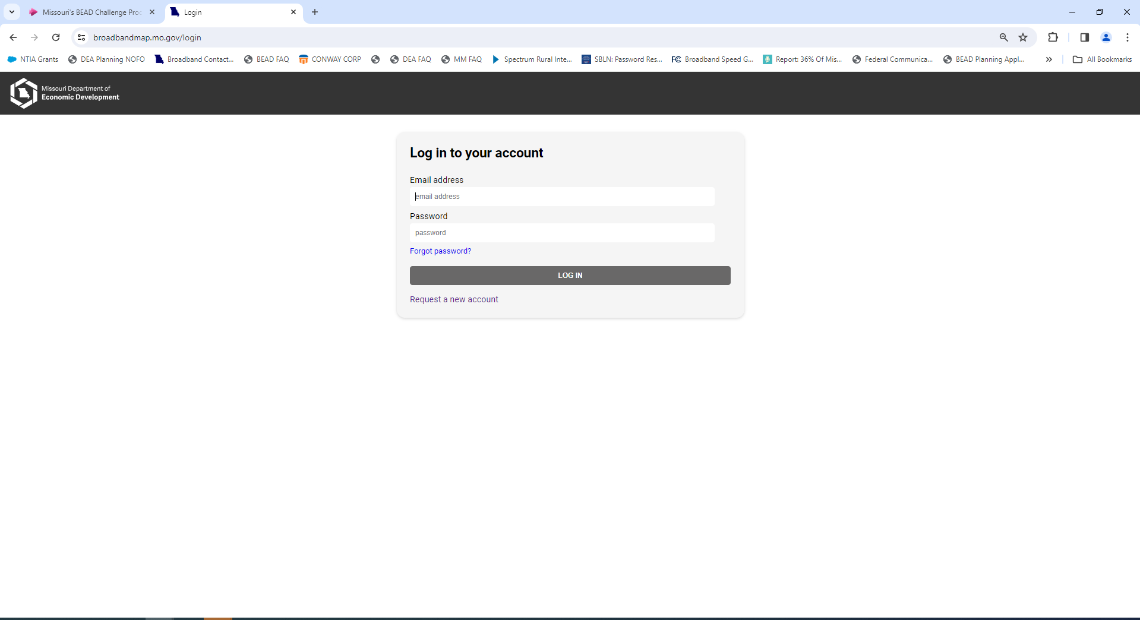

Slide 28
Digging into the Data
Provider availability reports: broadbandmap.fcc.gov
Data underlying Missouri’s map has/will be posted on ded.mo.gov/office-broadband-development/mapping
“Funding summary” reflects the provider and funding program for each funded location
“Location status” reflects the eligibility of each location based on availability and funding
Will post additional files at each stage of the process documenting further changes
Pre-challenge Modifications
Challenge Results
Final determinations

Slide 29
Digging into the Data: Licensing
All this data is posted by “location ID”. To map these points internally, you may want to link these IDs to addresses and coordinates
FCC broadband reporting is based on a location “fabric” produced by Costquest Associates
Challenge process participants can license to receive this fabric at no cost to them
With the information from OBD, this fabric should allow anybody to recreate our map for any internal analyses not supported by our portal
Broadbandusa.ntia.doc.gov/policies/CostQuest-Licensing

Slide 30
In Summary
Huge opportunity for places with limited broadband availability
Challenge process will be the last chance to establish BEAD eligibility
The challenge process cannot and will not solve every problem – there are cases where we are constrained by the overall rules of the program. It may help identify situations where we need to seek flexibility.
Reach out to broadband@ded.mo.gov or adam.thorp@ded.mo.gov

