Slide 1
SHOW ME BROADBAND
1
Dedicated to ensuring that every home, farm, and business in Missouri has fast, reliable, and affordable internet.
May, 2024

Slide 2
AGENDA
2
Challenge Process
Digital Equity NOFO and Applications
Charter Default – Eligible for BEAD – MAP and Next Steps
Sharing Access to Customer’s Location Data
What’s After Affordable Connectivity Program (ACP)
What’s On Your Mind
Administrative

Slide 3
Challenge Process
2
Was set to end April 23 but extended 15 days to May 8
End of first 2 weeks of challenge timeframe, had only about 5,000 challenges – last week had well over 120,000 (individual and bulk challenges – had several submitting bulk challenges)
Most common – the service is already offered or will be offered
Timeframes
May 8 to June 7 – rebuttals are due
June 8 to July 7 – OBD reviews the rebuttals
Continue to get information from the community level
Map - Missouri Broadband Availability Map

Slide 4
Digital Opportunity Act Allocations & Process
2
State Capacity Program
$1.44B nationally for states to implement their state Digital Equity Act Plans
MO Allocation - $14,237,940, which is the 1st of 3 allocations expected to be released over the next 3 years. (The next two will be smaller.)
Each has a 5-year period of performance
17 states received higher allocations than MO
DE Competitive Grants ($1.25B) open later (30 days after Capacity awards)
NOFO for the states to submit their applications for the funds is due May 8
Later after this date, sub-awardees will be able to apply for funds
Who is planning to apply for these funds?
OBD has a Digital Opportunity survey out – if you have not completed please do (on their website)

Slide 5
Charter RDOF Defaults
2
3 states impacted – Missouri, Wisconsin and Michigan (from 2020 award)
Turned in 133 CBGs, representing 2.4% of their RDOF locations
Charter was “assigned the most locations” in the RDOF auction at just over 1.05 million so about 25,200 locations turned back in the 3 states
2nd largest ISP in the country with 305 million internet subscribers in 41 states
Unforeseeable costs primarily associated with need for extensive utility pole replacements
Fine – receive no further support for the defaulted areas – return support for funds already received for these areas
Eligibility for BEAD funds?
Not for the same areas that default occurred (at least in round 1)
OBD working with NTIA on other eligibility

Slide 6
Charter RDOF Defaults
2
Missouri Impact
18 counties
7600 locations
OBD developed map of the defaulted areas and will be eligible for BEAD funds
No increase in funding from NTIA so this is a huge impact
Need to make sure providers are aware of these areas opening up
MAP ON NEXT SLIDE

Slide 7
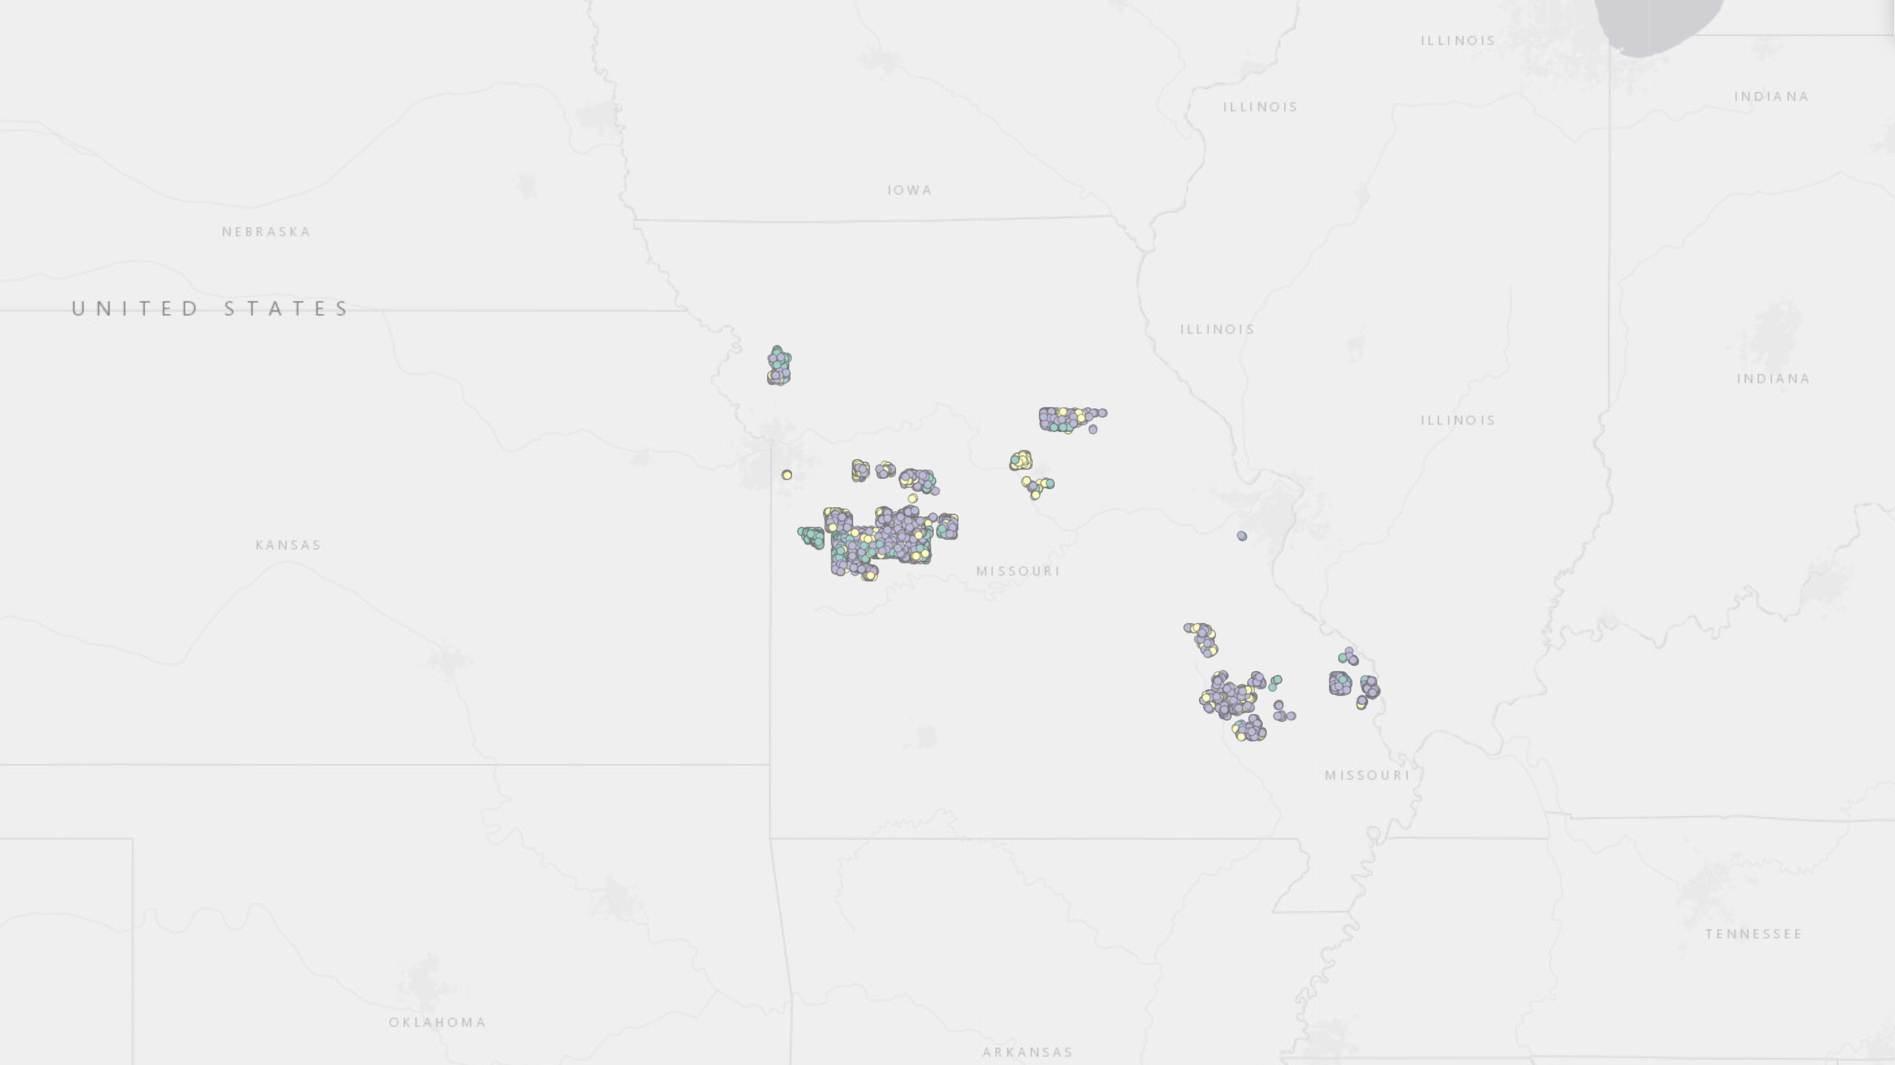
Charter RDOF Defaults
2

Slide 8
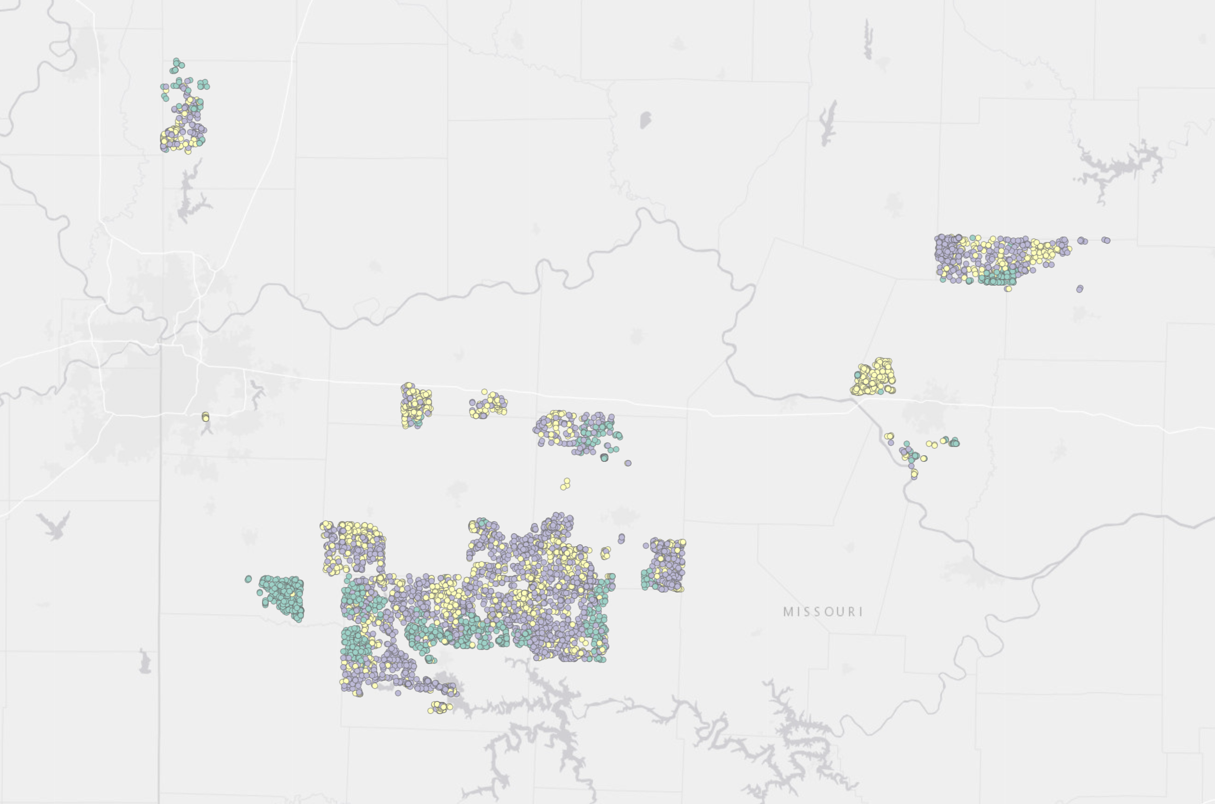
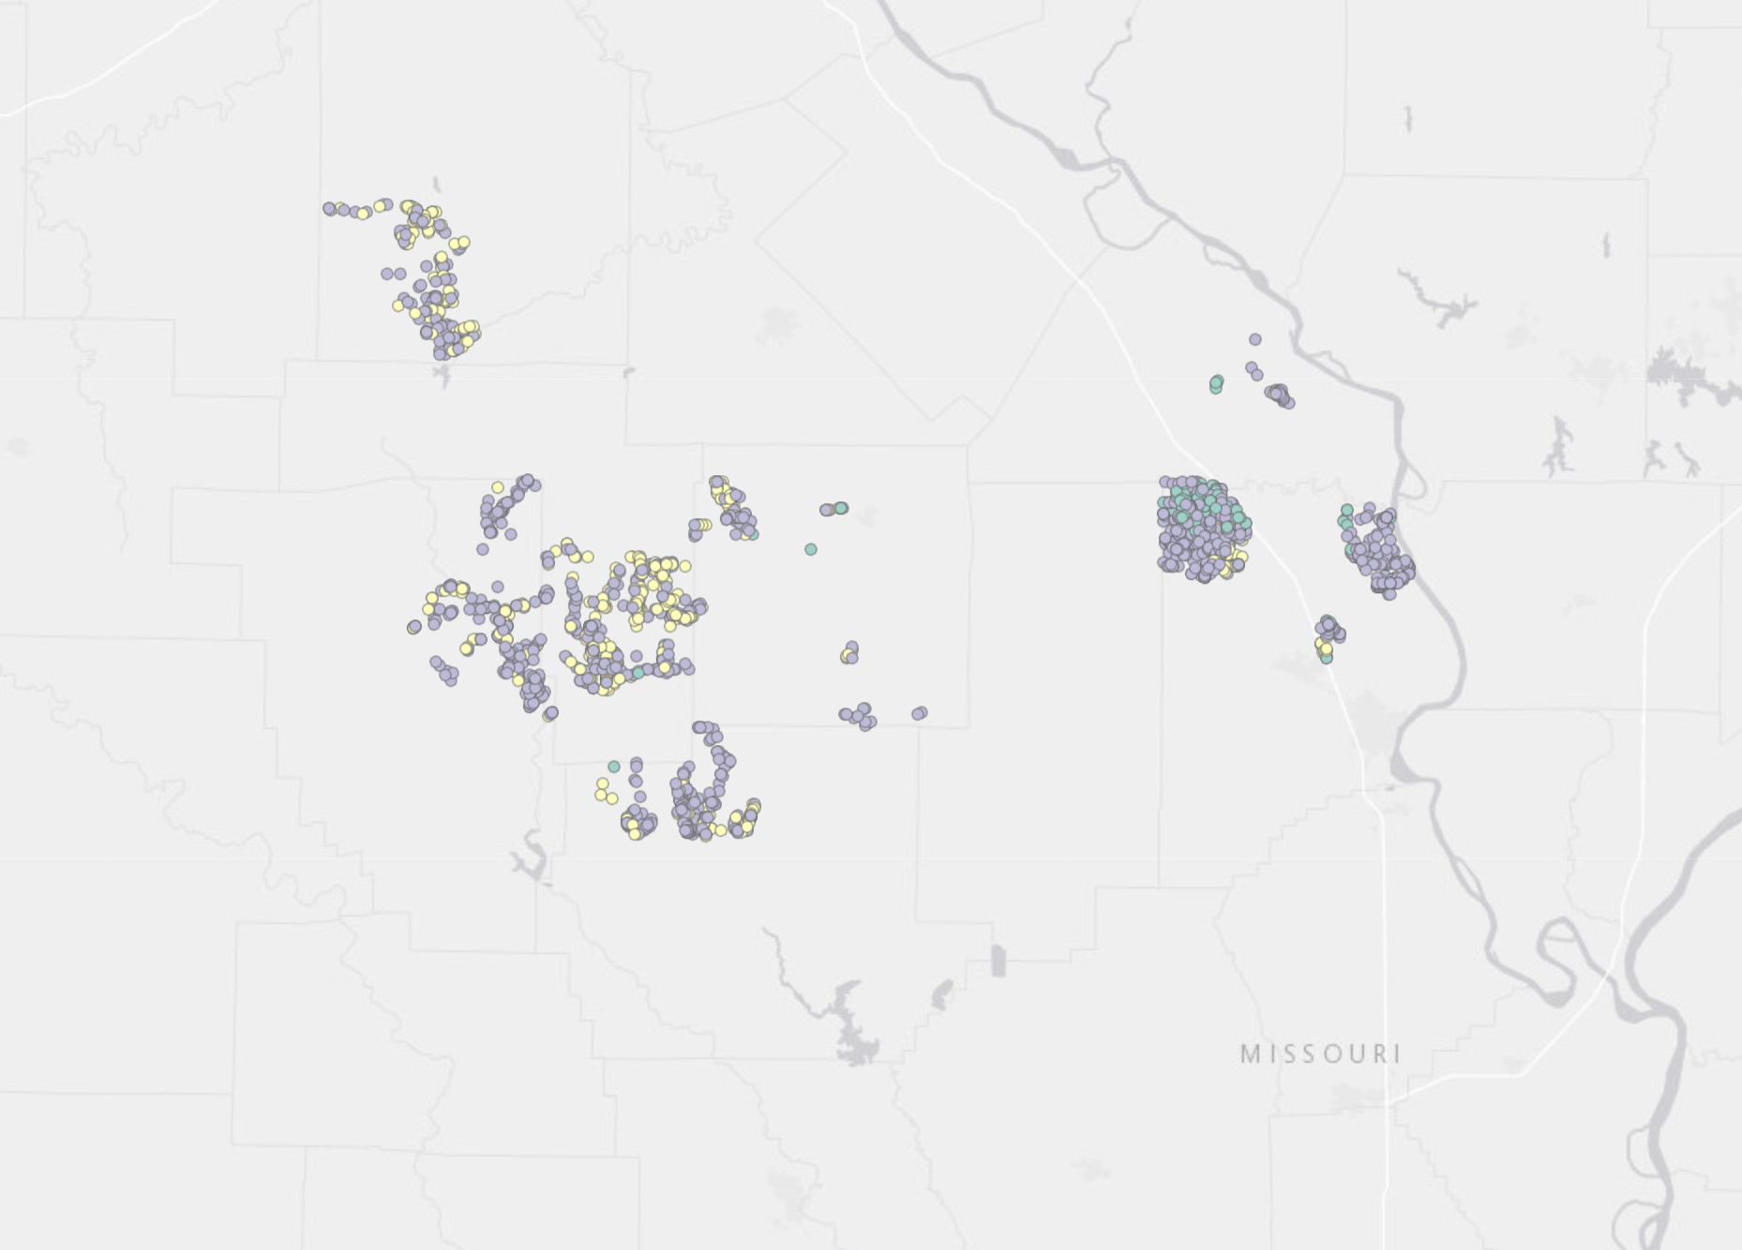
Charter RDOF Defaults
2

Slide 9
Providers Selling Off Customer Information
2
April 29 FCC assessed multiple fines to AT&T, Sprint, T-Mobile and Verizon totaling $200 Million for illegally sharing access to customers’ location data without customer consent and did not take measures to protect against unauthorized disclosure (sold information and it was resold)
Discussion on this

Slide 10
What’s After ACP - Any Hope?
2
Impact
MO has nearly 400,000 enrollees – 1 in 7
$75 per month is the median price for internet, which is out of reach for many low-income communities
The ACP benefit is a large piece of the BEAD program
The End Schedule
Full benefit ends in April; possible partial benefit in May
Only Congress can save ACP now
Federal Update – still lots of national traction and pushing to extend this subsidy

Slide 11
What’s After ACP - Any Hope?
2
Federal Update
Senator Fetterman, Pennsylvania introduced bill to make the “Promoting Affordable Connectivity Act – making the broadband internet program permanent
Take from appropriations process and incorporate it into USF distribution
Restructure USF distribution without raising rates on customers
Broadband providers and edge would finance the ACP, not passed on to the consumers
Discharge Partition – still out there
Rally – Tuesday
Senate Hearing Thursday (Drew attending)
Petition to ask providers to provide full subsidy in May

Slide 12
What’s After ACP?
2
State Actions
States should start having conversations about how they can address the affordability without the ACP
I have list of state legislations addressing this topic and there are a handful
All but 1 revolves around states using PSC and USF reform in state for the subsidy
New York has bill that requires all providers to have a $15 low -cost option for broadband
Pennsylvania House proposing legislation that would mirror the ACP
Establishing a program that would provide eligible households with $30 per month toward their BB service

Slide 13
What’s After ACP?
2
How will this impact Missouri?
How are organizations and providers on this call prepping for the end of ACP?
How will end impact ISP’s deployment plans
Any questions for the OBD since the BEAD process has heavy emphasis on the ACP subsidy
What should Missouri do about affordability?
How can Show Me Broadband make it happen?

Slide 14
Where Are We On Policy Items (left from April meeting notes as a reminder)
2
Policy Changes on BEAD program in MO
Received approval to mark areas whose sole source of internet comes from cellular fixed wireless service as “underserved” making these eligible to receive broadband infrastructure funding under BEAD
1 of 4 states that received this approval (so far, others pending)
OBD is adopting a flexible approach in terms of its low-cost option and overall Middle-Class Affordability Plan, awarding providers additional points for affordability commitments but not prescribing given pricing levels (pg. 144 MO Initial Proposal)

Slide 15
2
WHAT’S ON YOUR MIND?

Slide 16
Homework
2
Community Support – there are points given in the BEAD process for this category which would include a community letter of support. ISPs will be reaching out for these documents
Community/County Meetings – Rep Riggs and I are setting up 2/3 meetings to bring community leadership and ISPs together to figure out a plan for applying for BEAD funds. Let us know if you or someone would like us to schedule one.
Digital Opportunity Sub Awardee Grants – we are currently assisting 2/3 organizations to help prepare for submitting applications.
Pre-Qualification for BEAD apps – providers must do this step before BEAD application. (May 16 is due date)
Encourage ISPs to get in the area they are looking at – do it now!
Do not have to go with area but it will delay them getting applications filed if not done and allows OBD to draw the area

Slide 17
SHOW ME BROADBAND
12
Janie Dunning,
Missouri State Coordinator for Show Me Broadband
Formerly: USDA Rural Development Director; Missouri Farm Bureau Broadband Consultant
janiedunning@hotmail.com
janie@showmebroadband.org
(573) 289-4277

