Slide 1
Office of Broadband Development
BEAD Prep

Slide 2
Broadband Equity, Access, and Deployment Program

Slide 3
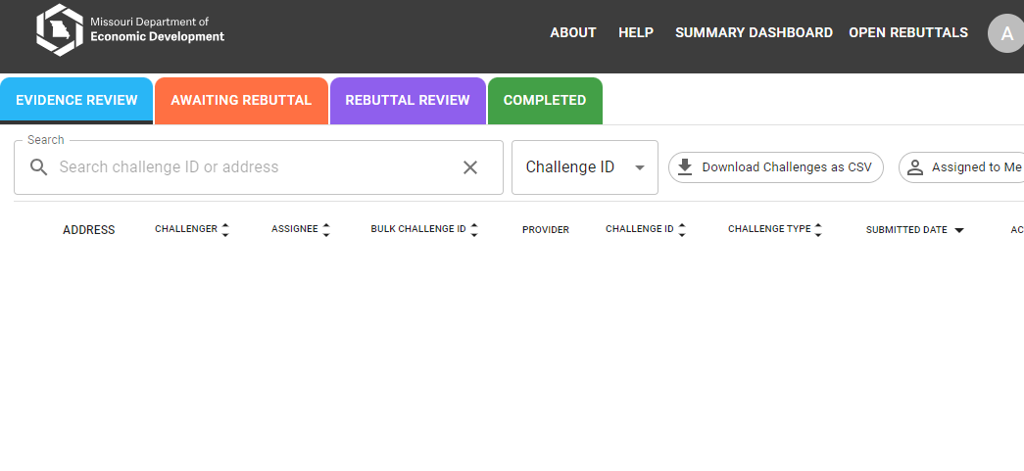
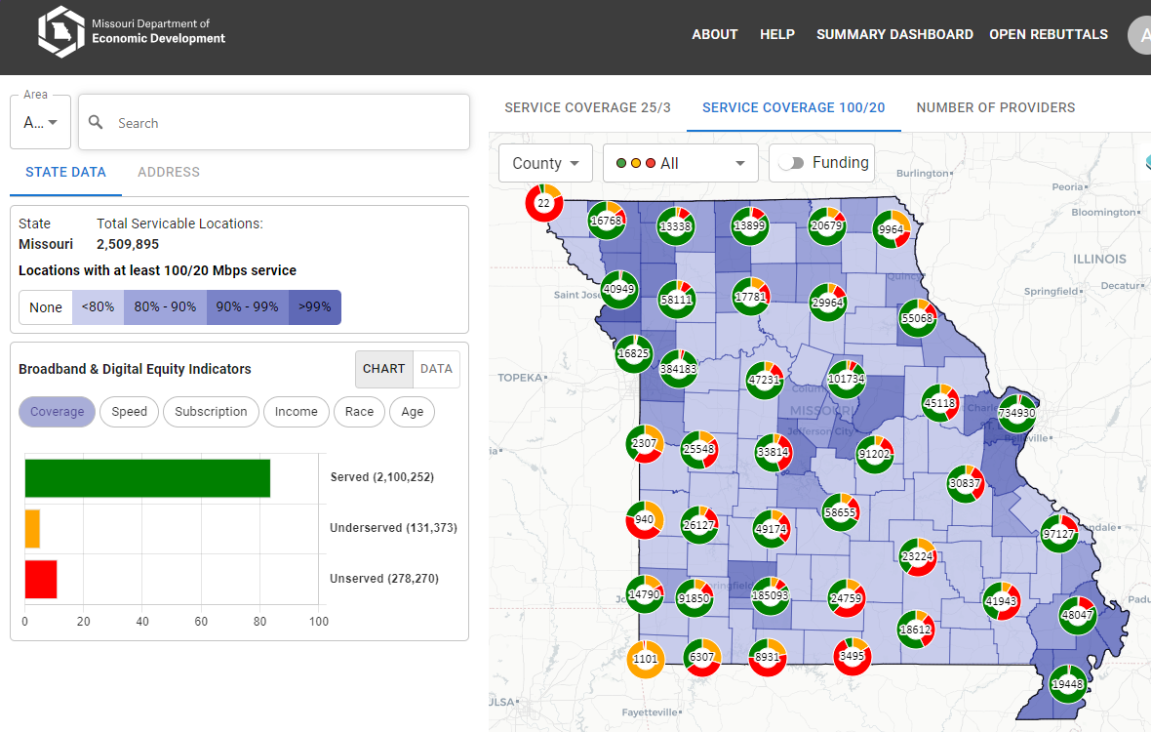
Statewide Broadband Mapping
BroadbandMap.mo.gov
Interactive mapping portal for presenting up-to-date data, including unserved/underserved/served locations and service availability by legislative districts
Challenge hub for submitting, rebutting, adjudicating and closing Additional challenges
Functionality for potential grant applicants to submit project areas
Through June 14TH

Slide 4
IIJA BEAD Funding
$1.736 billion
Goal – Connect All Missourians
Eligible Locations
Unserved and Underserved
Unfunded

Slide 5
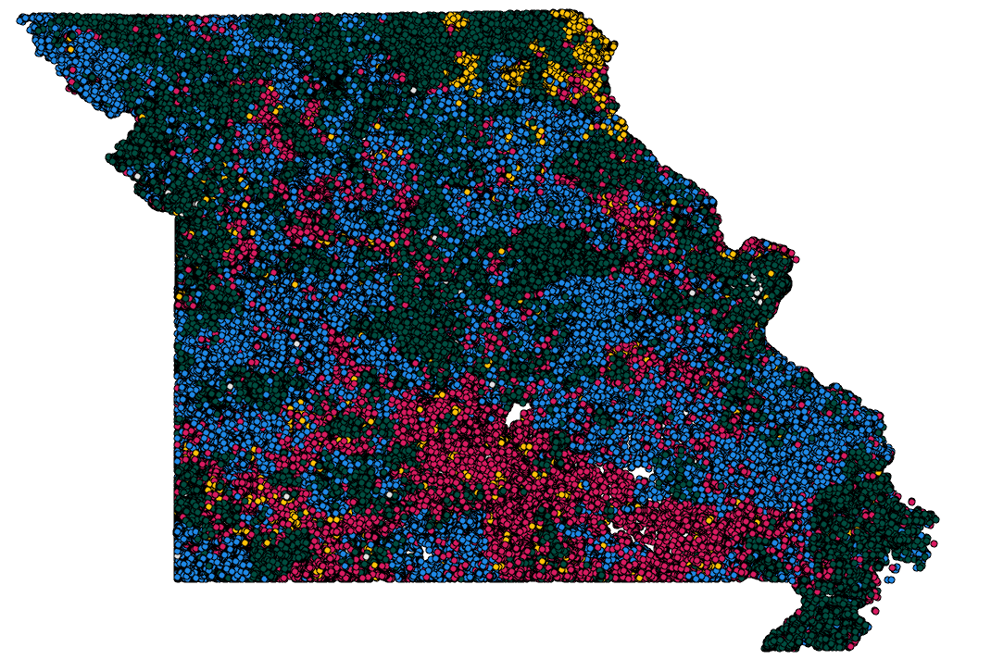
Where We Stand (Prior to Challenges/Defaults)
Unserved & Unfunded
139,228 locations
Underserved & Unfunded
64,001 locations
Estimated cost to serve:
$1.26 billion
Missouri’s BEAD allocation:
$1,736,302,708.39

Slide 6
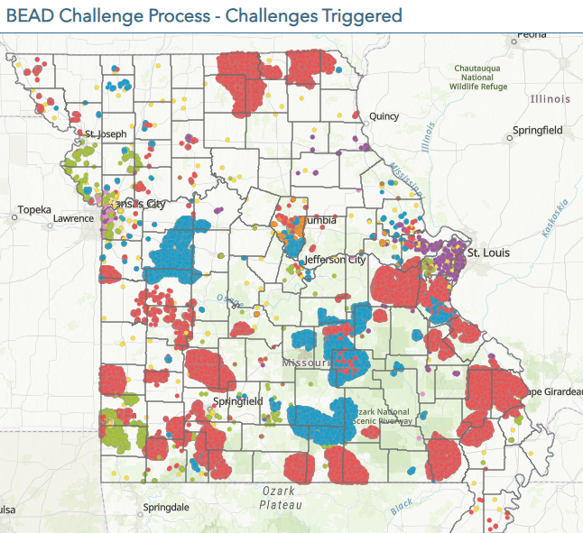
State Challenge
Together Team DED handled over 5000 Challenges impacting thousands of locations.
We are now in the Rebuttal Phase (30 day from acceptance of a challenge)
June 7 Rebuttal Deadlines begin to hit
Many areas eligible for open rebuttal

Slide 7
Thinking About Applying?

Slide 8
Timeline
Completed
Submission of Initial Proposal
Curing of Initial Proposal Volume 1 (Challenge Process)
Challenge Submission and Evidence Review
Ongoing
Approval of Initial Proposal Volume 2 (Program Rules and Grantee Selection)
Challenge Rebuttal
Upcoming
Subgrantee Pre-qualification – June 20/July 1 2024
Two Grant Rounds – 1st Beginning August/September 2024
Submission of Final Proposal – 365 days from plan approval.

Slide 9
BEAD Timeline
Aug. 8
June 7
OBD makes final challenge determinations
Most rebuttal windows close
June 14
Prequalification opens – pending grant portal
July 7
Publication of Application Area Map
Project Area RFI window ends
June 17 – July 1
NTIA must approve challenge results
Before Round One
NTIA must approve Initial Proposal Vol. II before Round 1
Before Round one
Round one awards opens
Aug. 15
Oct. 15
Round 1 closes. 60-day review window including sub-round, BAFO
Feb. 15
Round 2 opens (also 60 days for applications, 60 days for review)
Earliest possible date (Tentative to NTIA approval of locations)

Slide 10
Multiple Rounds of Applications
Round 1
60 day application window
Requirements
Less than Maximum BEAD Outlay
Minimum Score – 125 out of 360
$300 Million cap on applications (per provider)
BAFO
Sub-Round 1
Areas with no applications
30 day application window
After round one application window closes
Same Requirements
Announce Round 1 Awards
Round 2
If OBD determines is has insufficient funding to reach all locations, CAI’s and/or underserved locations are removed
No cap on applications
No minimum score
Maximum BEAD Outlay for Project Areas
Adjusted upward and shared prior to applications
BAFO
Sub-Round 2
Areas with no applications
Announce Round 2 Awards
Additional Rounds/Direct Negotiations

Slide 11
BEAD Project Areas – Provider Driven
Providers submit project areas
Areas they are interested in applying
Areas they would be willing to serve
OBD considers the areas and makes minor changes
To account for overlaps between
To eliminate minor gaps between project areas
Less than 10% increase in expected cost of project areas
OBD adds project areas where none were submitted
Clearly indicated on the maps
Example: MO-1
Tentative Map released
Approximately a month after completion of the challenge process
August 8 (Tentative)
Final project area map released
Upon NTIA approval of final location eligibility determinations

Slide 12
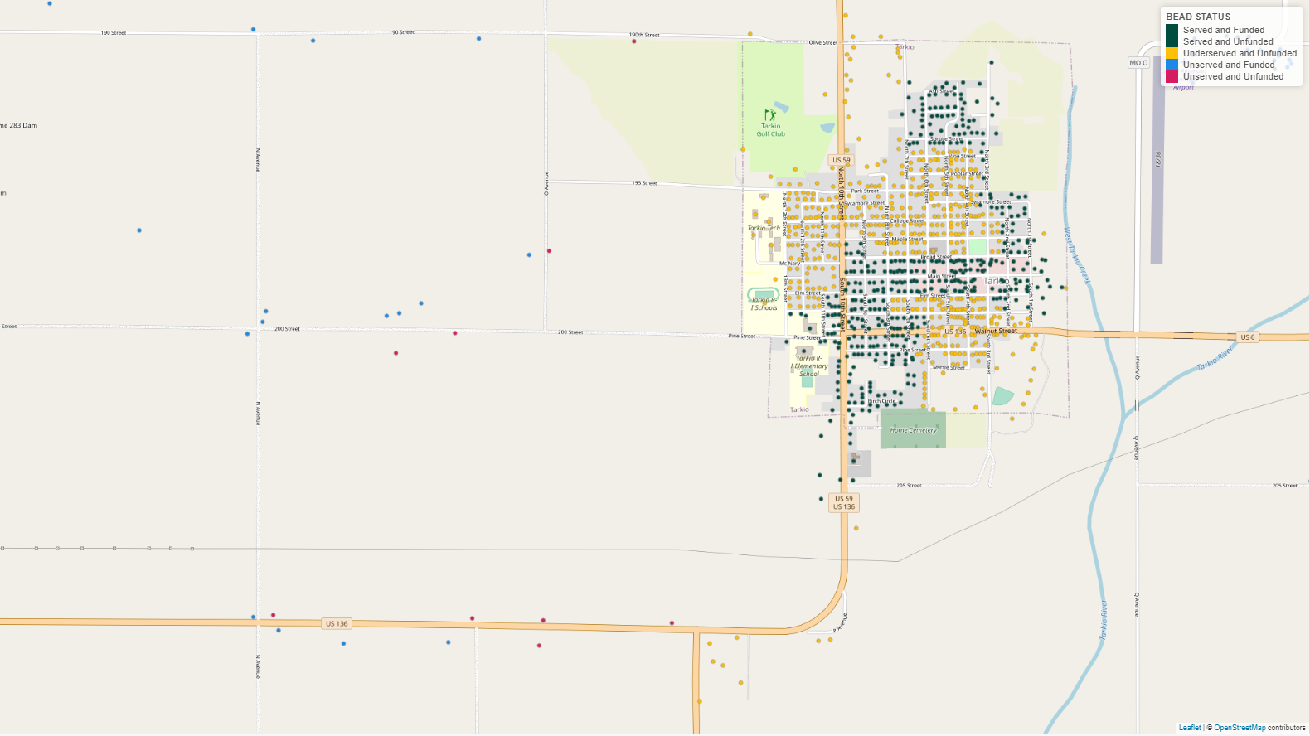
Request for Information:
Overlap Project Areas and Identify Outliers
OBD would use the submitted boundaries to create project areas – but doing this would create some areas with just a few locations (in small gaps and overlaps between project areas) and some locations that fall just outside of project area. Arrows indicate some of these situations

Slide 13
Request for Information: Clean up and Designate Application Areas
OBD would make limited edits to application areas to account for these outliers; no project area gains locations whose modeled cost is more than 10% of the original modeled cost
Area MO-1
Area 1
Area 2
Area 4
Area 3

Slide 14
Top of Mind Issues

Slide 15
BAFO – Best and Final Offer
Top TWO applications for an area are invited to BAFO
Additional applications are eliminated from contention for the award
Included in the BAFO Determination:
Any forward looking scoreable portion of the application.
Examples:
Grant Funding Requested
Timeline
1 Gig Plan Cost
45 days after application window closes

Slide 16
Maximum BEAD Outlay
Amount of grant funding requested compared to the amount OBD believe it can spend to serve the project area and still reach ALL locations.
Not simply the models out put but the amount OBD can afford to spend.
If model says a project areas should cost 2% of all the cost across the state, OBD would allow up to 2% of our allocation to reach that area.
All ARPA awarded project would have been fundable given the current modeling. (Many were in tough to reach and expensive areas.)
Outlay adjusted between rounds to account for savings in round one
OBD not sharing MBO in prior to Round One
Planning to share prior to Round Two
Large Scoring Element – Up to 100 points
Not scoring on Matching Funding
More points to the project requesting fewer grant funds

Slide 17
Matching Requirement
Generally speaking BEAD can fund up to 75%
25% match requirement
Can fund beyond 75% in NTIA designated “Extremely High-Cost Areas”
https://rpubs.com/Adam_Thorp/high-cost
Exploring flexibility in nearby areas
What will OBD count as Match?
OBD will try to be as flexible as possible with measurable matches to get to the 25% match requirement
OBD can seek additional flexibility from NTIA in areas requiring more that 75% to reach with service.
We need to see applications to be able to make these claims.

Slide 18
Labor Requirements
Similar to labor information required for MO ARPA BIP
Per the BEAD NOFO pages 91-92 for projects over $5,000,000.00:
OBD will not require subgrantees to pay wages at rates not less than prevailing wage through Davis-Bacon. Subgrantees not meeting DB would be required by NTIA to report the following:
Number of contractors and sub-contractors working on the Project;
Number of workers on the Project hired directly and hired through a third party;
The wages and benefits of workers on the Project by classification; and
Whether those wages are at rates less than those prevailing. – [yes or no question]
These pieces needed for post award reporting, not through the application process

Slide 19
Labor Requirements
In lieu of certifying the subgrantee would use a unionized project workforce or pre-hire collective bargaining agreement, they would be required by NTIA to submit a project workforce continuity plan. (As it was for the ARPA BIP application):
Steps to ensure the Project has ready supply of appropriately skilled and unskilled labor to ensure construction is completed throughout the life of the Project (as required in Section IV.C.1.e), including
a description of any required professional certifications and/or in-house training, Registered Apprenticeships or labor-management partnership training programs, and partnerships with entities like unions, community colleges, or community-based groups;
Steps taken to minimize risks of labor disputes and disruptions that would jeopardize the project;
Steps taken to ensure a safe and healthy workplace that avoids delays and costs associated with workplace illnesses, injuries, and fatalities,
Descriptions of safety training, certification, and/or licensure requirements for all relevant workers (e.g., OSHA 10, OSHA 30, confined space, traffic control, or other training required of workers employed by contractors), including issues raised by workplace safety committees and their resolution;
The name of any subcontracted entity performing work on the Project, and the total number of workers employed by each such entity, disaggregated by job title; and
Steps taken to ensure that workers on the Project receive wages and benefits sufficient to secure an appropriately skilled workforce in the context of the local or regional labor market.
Workforce continuity plan is required to be submitted for all applicants. It factors into various pieces of the scoring including the “Fair Labor Practices” and “Equitable Workforce Development and Job Quality”
BEAD NOFO requires Workplace Safety Committees.
Outlined in Missouri’s Initial Proposal Volume II.

Slide 20
Letters of Credit/ Performance Bonds
NTIA’s BEAD NOFO requires a Letter of Credit or Performance Bond of no less than 10% of award amount
Cyber Security Requirements
NTIA’s BEAD NOFO requires an awarded provider to have a cybersecurity plan.
OBD will ask for a narrative in the prequalification application and full plans prior to signing grant agreements.
NTIA guidance has been that OBD must certify that cyber security plan exist
OBD is required to have them in the event NTIA requests them.
Standard:
NIST Cyber Security Framework 2.0 (https://nvlpubs.nist.gov/nistpubs/CSWP/NIST.CSWP.29.pdf)

Slide 21
Build America Buy America
BABA requirement apply to BEAD projects
NTIA released waiver impacting material not produced in America
https://www.commerce.gov/sites/default/files/2024-02/BABA%20Waiver%20Signed.pdf
Unknown – BABA reporting Requirements
NTIA has promised additional guidance will be available soon

Slide 22
Extremely High Cost Per location Threshold
BEAD is a fiber focused program
EHCPLT is where OBD can fund alternative technologies
Reliable broadband service
Licensed Fixed Wireless
As of today, does not include satellite
OBD believes NTIA will be releasing guidance on Low Earth Orbit Satellite soon
OBD Process
Prior to Round 1
Advisory Figure
After receiving applications
Preliminary EHCPLT
Prior to Round 2
Advisory Figure
After Receiving applications
Final EHCPLT (No higher than Preliminary)
Figure will be revised down through the process to allow for the savings necessary to reach all locations.

Slide 23
Low Cost / Affordability Requirements
NTIA’s BEAD NOFO Requires both a low-cost offerings and promotion of general affordability
Low-Cost Plan
Must be made available to locations that qualified for ACP
Plan must be approved by NTIA
OBD is in final negotiation with NTIA about the plan.
Seeking flexibility to meet the needs of consumers and the projects
NTIA has indicate they are working on a plan to certify who qualifies for these rates (potentially working with FCC)
Plan can be adjustable over time
Plan must last the entire performance period (10 years)
Affordability (NTIA Mandated Primary Score Criteria)
Scoring portion of application
1 Gig/Gig plan
Score starts at $145
100 point possible for a plan costing $45
0 points for a plan costing $145 or more

Slide 24
What to do next?
Submit project areas
Through:
Map site
www.broadbandmap.mo.gov
Draw your own area tool
RFI submission survey
https://survey123.arcgis.com/share/42cd1ffbbab740978fe41cdf0b690471?portalUrl=https://mogov.maps.arcgis.com
Shapefiles
Over 600 Project areas submitted

Slide 25
What to do next?
Secure local Support
OBD Released Local Support Template
https://ded.mo.gov/media/pdf/bead-local-coordination-template
Respond to challenges or file rebuttals
Plan for applying

Slide 26
Thank you!

