Slide 1
Office of Broadband Development
July 2024

Slide 2
Ongoing Program Update

Slide 3
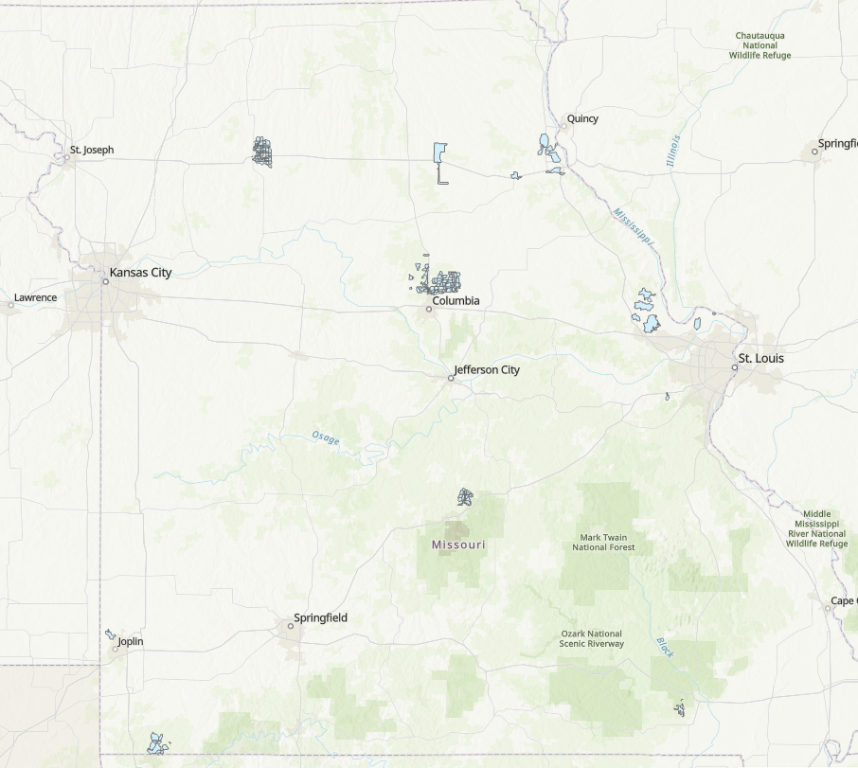
NTIA Broadband Infrastructure Program
Award Totals
Projects – 19
Connections – 12,935
Award Amount – $42.2 million
Project Cost – $62.7 million
Progress
Completed Projects – 9
In Progress – 7
Total reimbursements – 115
Reimbursed Funds – $26,116,913.74
Note: 3 awarded projects were returned by the subrecipient.

Slide 4
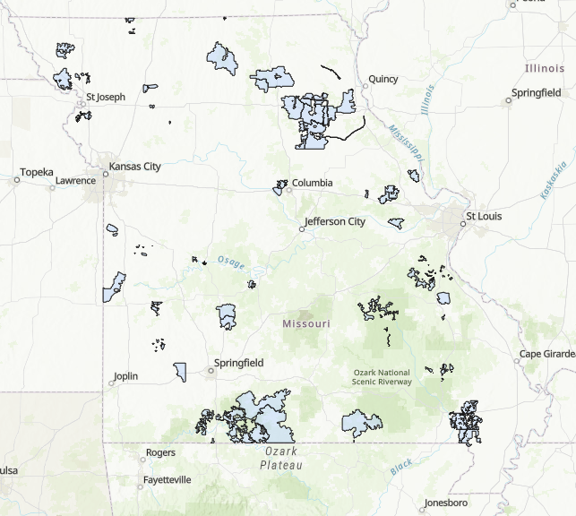
ARPA Broadband Program
Award Totals
Projects – 60
Connections – Over 54,000
Award Amount – $261 million
Project Cost – Over $386 million
Progress
Completed Projects – 9
In Progress – 32
Beginning Soon – 19
Reimbursements processed – 146
Reimbursed Funds – $66,501,801.46

Slide 5
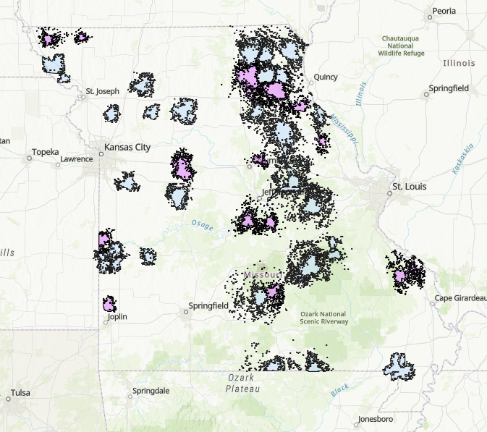
ARPA Cell Towers Grant Program
Award Totals
Projects – 43 New Towers
Improved Connections – 35,684
Counties Impacted – 55
Award Amount – $20 million
Total Project Cost – Over $28.1 million
Progress
Stage 1 of Pre-Construction – 9
Stage 2 of Pre-Construction – 33
Stage 3 of Pre-Construction – 0
Construction Phase – 1

Slide 6
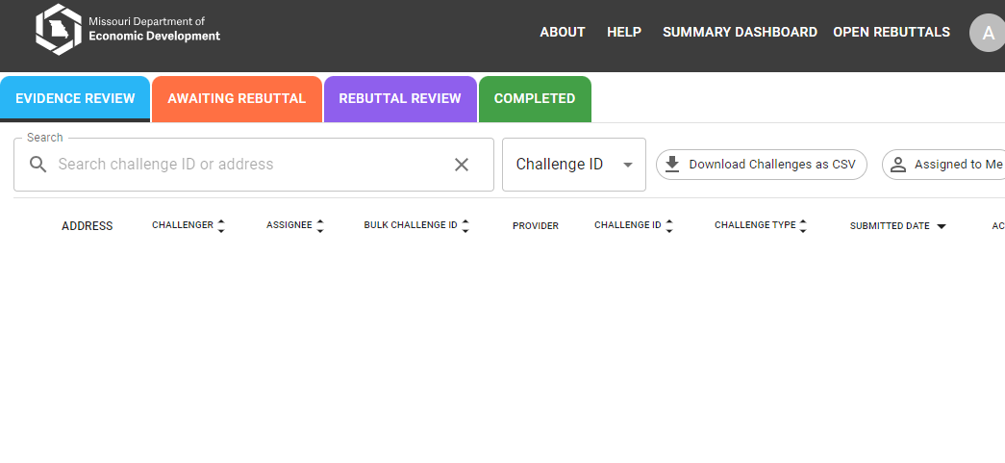
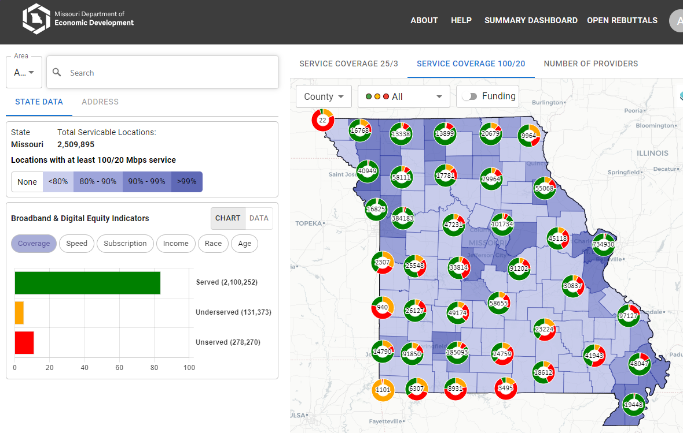
Statewide Broadband Mapping
BroadbandMap.mo.gov
Interactive mapping portal for presenting up-to-date data, including unserved/underserved/served locations and service availability by legislative districts
Challenge hub for submitting, rebutting, adjudicating and closing challenges
Additional functionality for potential grant applicants to submit project areas

Slide 7
Broadband Equity, Access, and Deployment Program

Slide 8
IIJA BEAD Funding
$1.736 billion
Goal – Connect All Missourians
Eligible Locations
Unserved and Underserved
Unfunded

Slide 9
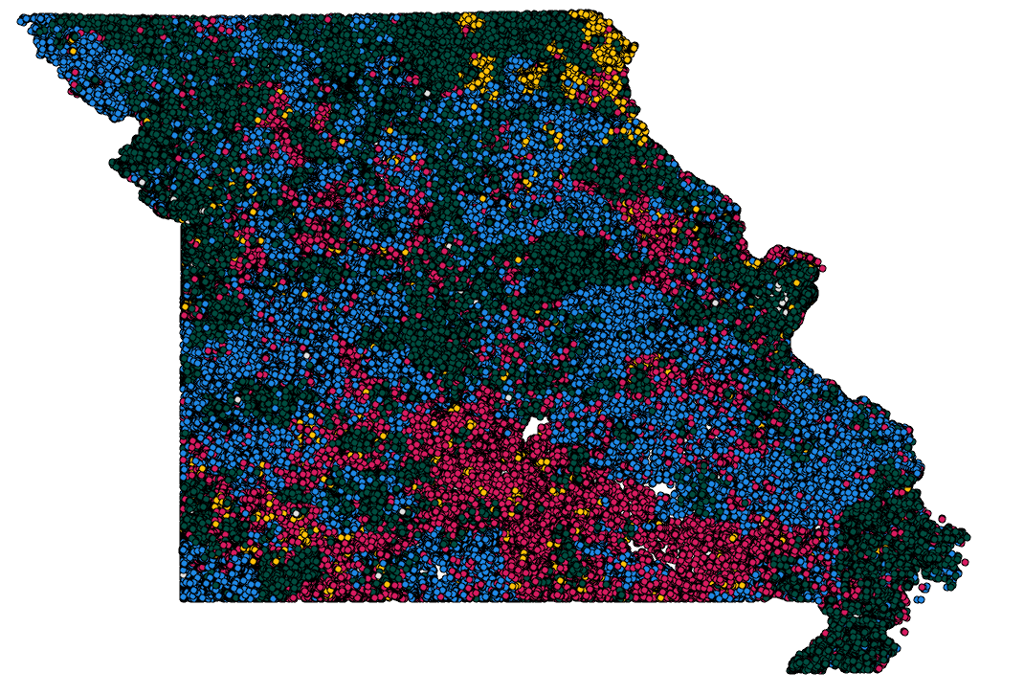
Where We Stand
Unserved & Unfunded
139,228 locations
Underserved & Unfunded
64,001 locations
Estimated cost to serve:
$1.26 billion
Missouri’s BEAD allocation:
$1,736,302,708.39

Slide 10
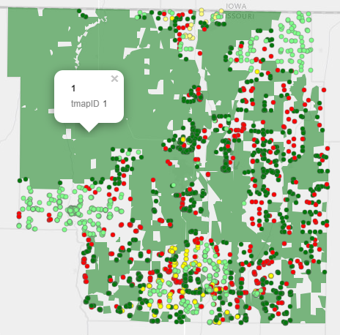
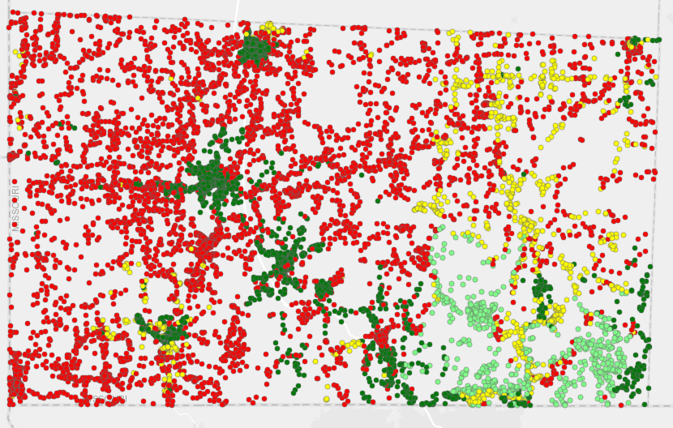
Typical Missouri Scenarios

Slide 11
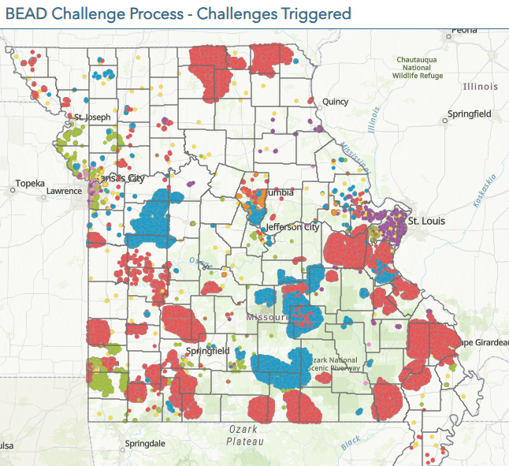
State Challenge
Together Team DED handled over 5000 Challenges impacting thousands of locations.
We are now in the Rebuttal Phase (30 day from acceptance of a challenge)

Slide 12
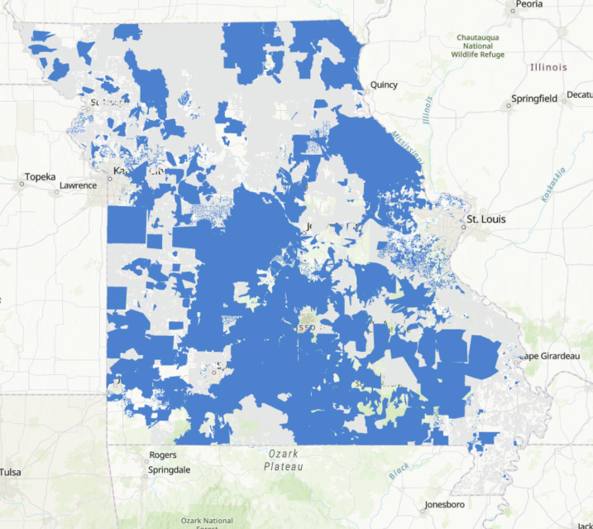
Request for Input (RFI) Closing
RFI process closed on June 14th EOD
Received over 1500 project areas from 41 providers

Slide 13
Timeline
Completed
Submission of Initial Proposal
Curing of Initial Proposal Volume 1 (Challenge Process)
Challenge Submission and Evidence Review
Ongoing
Approval of Initial Proposal Volume 2 (Program Rules and Grantee Selection)
Challenge Final Determinations
Subgrantee Pre-qualification – Opened July 3, 2024
Upcoming
Two Grant Rounds – 1st Beginning September 2024
Submission of Final Proposal – 365 days from I.P. approval.

Slide 14
Missouri’s Digital Opportunity Expansion Programming

Slide 15
Statewide Digital Opportunity Plan (DEA)
Plan is divided into seven main sections:
Executive Summary
Vision & Introduction
Current State of Digital Equity
Implementation Strategy
Conclusion
Appendix
References
Funds non-infrastructure broadband work
Total – Approx. $14 Million
Funding for first NOFO
2 additional NOFOs with additional funding later

Slide 16
Our Vision
As an office within the Missouri Department of Economic Development (DED), the Office of Broadband Development (OBD) is primarily concerned with enabling citizens to utilize the full capacity of the internet to enhance economic outcomes.
As such, OBD strives every day to realize the vision of a Missouri where every citizen, regardless of their financial, geographic, or demographic background, has access to the complete set of digital skills, technology, and resources necessary to realize their full potential within the digital economy.

Slide 17
Timeline
October-November 2023
January 26, 2024
Spring 2024
Draft Digital Opportunity Plan Public Comment Period
Final Digital Opportunity Plan submitted to NTIA
DE Capacity Grant NOFO released
DE Capacity Grant Due May 28
Summer 2024
DE Competitive Grant opens for application
Fall 2024-Winter 2028
DEA Capacity Grant funded activities

Slide 18
Thank you!

