Slide 1
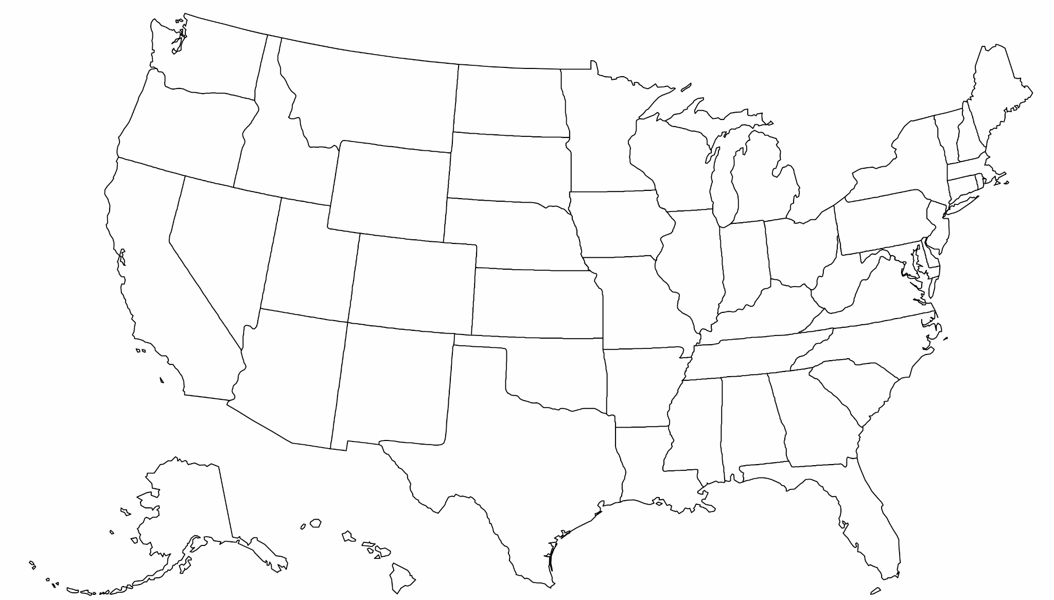
State Connections
The broadband working group for state legislators
First Friday of Every Month
4:00 ET / 3:00 CT / 2:00 MT / 1:00 PT
WE WILL BEGIN SHORTLY!

Slide 2
Introductions
Membership has grown (100+ spanning Maine to Hawaiʻi), so let's introduce ourselves:
If you are new to State Connections, please introduce yourself:
Name
State
Role
Topic of Interest

Slide 3
Topics for Discussion
Please offer suggestions! (in chat or out loud)
Brief FCC defaults discussion | Gigi Sohn
Legislative Questionnaire for State Office of Broadband Please give us feedback on these! We will have a final document on Monday.
Representative Louis Riggs Updates and Interactive Questions
Miscellaneous topics Affordability, coalition suggested topics, State Connections growth update
Notes:
DE Summary

Slide 4
FCC Defaults Discussion
Gigi Sohn

Slide 5
Legislative Questionnaire Guide for State Office of Broadband (1 of 3)
Broadband Office –
How many staff are assigned to the State Broadband Office?
How is the State Broadband Office funded (through another state agency, line item in budget)?
State Funding –
What funds, if any, does the state contribute to broadband (amounts and purpose, administrative or program)?
Is the Office of Broadband only supported by federal funds or does the state contribute state funds?
Affordability –
What is the state doing to address broadband affordability (especially without the Affordable Connectivity Program?
There is a requirement for the BEAD program that states have a low- cost plan. What is the requirement for your state?
It is also required for the BEAD program that there be a middle- income plan. What is the requirement for your state?
Is your state only relying on the BEAD low- cost plan to address affordability or are other practices in place?
What does “affordable” mean in your state to make broadband accessible to all?
Is urban broadband infrastructure in the states’ cities adequate? The Markup published a study on this in 2022, showing that areas in historically redlined areas often pay more for worse service than non-redlined areas.

Slide 6
Legislative Questionnaire Guide for State Office of Broadband (2 of 3)
Defaults –
Have there been any provider defaults for previously funded federal or state awards? If yes, where are these defaults and what is the number of locations impacted?
Is your Office of Broadband aware of any providers at risk of defaulting?
How will the state address future gaps in broadband infrastructure, either from defaults, new construction, or otherwise?
BEAD Funding –
What is the amount of BEAD funding awarded to the state for broadband infrastructure?
Each state has a map of the state showing eligible locations for BEAD funding. This map can show you what your district/area needs are in broadband. Obtain a copy of the map and discuss your areas with the Office of Broadband.
What is the status of the BEAD map challenge process in the state?
Where are the areas identified as “high-cost” areas that might not have to meet the 25% match requirement?
Has the Office of Broadband established all of the project areas?
Does the Office of Broadband expect the BEAD funds to reach all unserved locations in the state?
Does the Office of Broadband expect any funds remaining after reaching all the unserved locations in the state? If so, what are the planned use of the remaining funds?
What broadband speed has been set for your state as the acceptable speed (this speed should at least match 100 Mbps download and 20 Mbps upload to match the BEAD requirement).

Slide 7
Legislative Questionnaire Guide for State Office of Broadband (3 of 3)
BEAD Funding –
What is your Office of Broadband hearing from internet service providers about issues with the BEAD infrastructure program?
How is the Office of Broadband preparing for the Digital Equity grant programs? Do they have a plan to help provide devices and promote cybersecurity, training, and job-related skills?
What is the amount of NTIA funding awarded to the state for Digital Equity?
Legislative Concerns and Assistance –
What partners, nonprofits, ISPs (providers), or others that I may need to be engaged with are in my legislative district or area?
Are there any state legislative needs that the Office of Broadband has identified; administrative, program, permitting, right of ways, easements, tax exemptions for broadband grants, and others?
What else do you want to share with us and how else can we help make sure fast, reliable, affordable broadband is available to all in our state?

Slide 8
Representative Louis Riggs
Updates and Interactive Questions

Slide 9
Miscellaneous Topics
Affordable Connectivity Program (ACP) informational sheet – status
Any Other Topics You Want to Discuss Today?
State Connections Growing!
41 states have legislative members
Only 9 states not represented
Missouri, Wisconsin and Ohio each have the most representation
About 170 members
Spread the word – we can make a difference for broadband!
AUGUST MEETING IS CANCELLED!

Slide 10
Contact Information
Louis Riggs
State Representative, Missouri District 5
Chairman Workforce and Infrastructure Development Committee
RepRiggs@ShowMeBroadband.org
Janie Dunning
State Coordinator for Show Me Broadband
Formerly: USDA Rural Development State Director, Missouri Farm Bureau Broadband Consultant
janiedunning@hotmail.com (573) 289-4277
Drew Garner
Director of Policy Engagement
Benton Institute for Broadband & Society
dgarner@benton.org, (314) 803-7187
Reid Sharkey
Community Broadband Specialist and Research Associate
Benton Institute for Broadband & Society
reid@benton.org, (703) 400-2106

