Slide 1
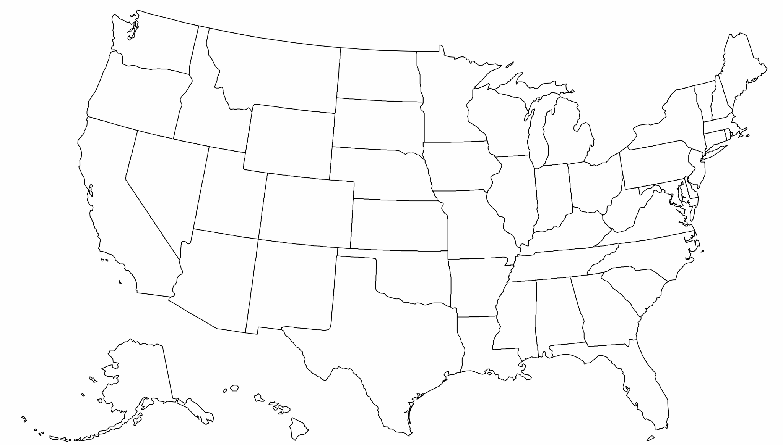
State Connections
The broadband working group for state legislators
First Friday of Every Month
4:00 ET / 3:00 CT / 2:00 MT / 1:00 PT
WE WILL BEGIN SHORTLY!

Slide 2
Agenda
Please offer suggestions! (in chat or out loud)
Topic: Staffing Your State Broadband Office
Opening Questions
Expert Discussion
Q&A
Notes:
DE Summary

Slide 3
Opening Questions
Please answer out loud or in the chat (if you don’t know the answer, that’s good to share too!)
How many staff are in your state’s broadband office?
Does your office have state funding or only federal?
Notes:
DE Summary

Slide 4
Expert Discussion
Rep. Riggs and Missouri Broadband Director BJ Tanksley
Number of staff
Description of positions
Value of a well-staffed office
Long term needs
How can legislators help
Notes:
DE Summary

Slide 5
Q&A
Staffing your Broadband Office
Notes:
DE Summary

Slide 6
General Updates & Discussion
Notes:
DE Summary

Slide 7
Contact Information
Louis Riggs
State Representative, Missouri District 5
Chairman Workforce and Infrastructure Development Committee
RepRiggs@ShowMeBroadband.org
Janie Dunning
State Coordinator for Show Me Broadband
Formerly: USDA Rural Development State Director, Missouri Farm Bureau Broadband Consultant
janiedunning@hotmail.com (573) 289-4277
Drew Garner
Director of Policy Engagement
Benton Institute for Broadband & Society
dgarner@benton.org, (314) 803-7187

Slide 8
B J TANKSLEY, Director, Missouri Office of Broadband
Notes:
DE Summary

