Slide 1
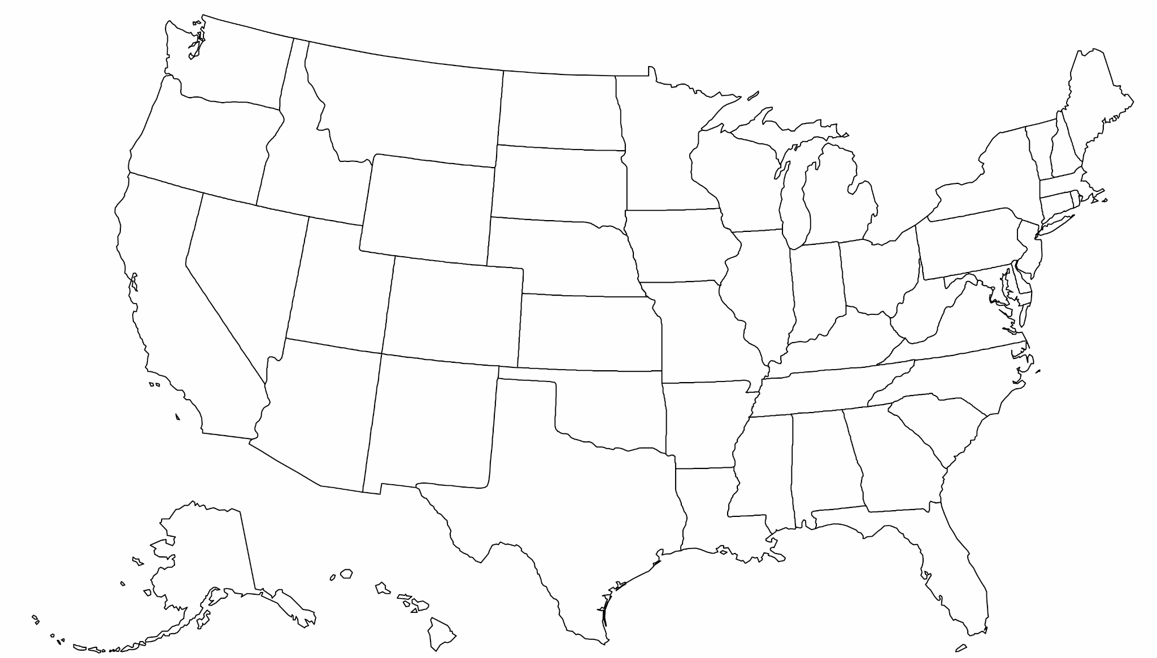
State Connections
The broadband working group for state legislators
First Friday of Every Month
4:00 ET / 3:00 CT / 2:00 MT / 1:00 PT
WE WILL BEGIN SHORTLY!

Slide 2
Agenda
Please offer suggestions! (in chat or out loud)
Introductions
General Discussion — What’s Happening In Your State?
Recent State Broadband Legislation
Update from Rep. Riggs — NCSL, IAC, and More.
Group Updates and Feedback:
Stateside
Meeting Timing
Questions to Ask Your State Broadband Office
Notes:
DE Summary

Slide 3
Introductions
Membership has grown, so let's introduce ourselves:
Name
Position
State
Topic of Interest
We now have members in all but 7 states! What a great way to share information about successful broadband.

Slide 4
General Discussion
What’s Happening In Your State?

Slide 5
General Discussion
Latest Guidance from NTIA on Allowance of Satellite Technology Comments from Members
Proposals coming in from high-cost areas are too expensive and not enough money
2 requirements of BEAD 1) fiber priority and 2) serve everyone. Must consider alternatives where feasible
Issue in community where provider serves half the town with fiber but only wireless in other half. Need resolution to this issue
Contracts – one state includes enforceable commitment that if receive BEAD funds, the commit to finishing any other funding (RDOF, CAF, etc.)

Slide 6
Recent State Legislation
Activities from 2023 and 2024
Speed: Raise requirements for upload and download speeds.
Data Disclosure: Require ISPs to annually disclose broadband service and location data.
Digital Literacy: Establish and fund digital learning centers and digital literacy programs.
Dig Once Policy: Require construction projects to coordinate with ISPs and/or install excess conduit.
State Offices: Fund state broadband office and staff.
Tax Incentives: Exempt eligible broadband equipment from state taxes (or give tax credits).
Fund Devices: Funding to purchase mobile hotspots and computer devices
Public Service Commissions: Require PSCs/PUCs to set standards and oversee broadband.
Establish Boards: Establishing state broadband Advisory Boards/Councils.

Slide 7
Updates from Rep. Riggs
NCSL Summit, Intergovernmental Advisory Committee (IAC), and more
IAC – send Rep Riggs any suggestions for the Federal Communications Commission (FCC) to make improvements to access to broadband, programs or policy
Working with Senator Hawley on legislation for defaulted provider funds to be returned to the state for broadband deployment
If any BEAD funds remain after reaching the served and underserved with infrastructure, they may be used for non-deployment purposes, i.e. affordability, digital equity/opportunity, etc.

Slide 8
Group Updates and Feedback
Stateside
Would you like to receive Stateside updates on activity in your state?
Stateside:
Weekly and monthly updates on each state.
Tracking state and federal deadlines, RFPs, FAQs, meeting dates, and award announcements.
Example in September 2nd report of national information:
On August 27, the National Telecommunications and Information Administration (NTIA) released draft policy guidance that provides states and territories additional clarity as to how to consider projects using alternative technologies for the BEAD Program. Additional agency comments are available here. Submissions will be accepted by midnight ET on September 10.
Example in September 2nd report of state information:
ILLINOIS - The Illinois Office of Broadband has expanded crowdsourced Digital Equity resources, including broadband and digital equity data, digital skills training programs, and digital navigator models.The Connect Illinois Round 4 (BEAD) Subgrantee Webinar Series are scheduled for Wednesdays from 12:00 p.m. - 1:00 p.m. CT from August 28 to September 18. Register here.
LOUISIANA - state expects to be the first to award BEAD Program funds. The first round of applications closed August 29. The second round of BEAD grants is also expected to have a 2-week deadline, with final decisions for the entire $1.3 billion BEAD awarded to the state no later than November 1.
We will start sending you this information!

Slide 9
Group Updates and Feedback
Meeting Times
Does the current meeting time work for you?
First Friday of the month
4:00 ET / 3:00 CT / 2:00 MT / 1:00 PT
We have not heard from anyone requesting to change this day and time so will continue meetings as scheduled.

Slide 10
Group Updates and Feedback
Homework
How many staff does your state broadband office employ?
How is your state broadband office funded?
Please take a moment to send us an email with the above 2 pieces of information. We will share the information on the next call.

Slide 11
Contact Information
Louis Riggs
State Representative, Missouri District 5
Chairman Workforce and Infrastructure Development Committee
RepRiggs@ShowMeBroadband.org
Janie Dunning
State Coordinator for Show Me Broadband
Formerly: USDA Rural Development State Director, Missouri Farm Bureau Broadband Consultant
janiedunning@hotmail.com (573) 289-4277
Drew Garner
Director of Policy Engagement
Benton Institute for Broadband & Society
dgarner@benton.org, (314) 803-7187

