Slide 1
The Pole Attachment Problem Jake Varn Broadband Access Initiative
June, 2025

Slide 2
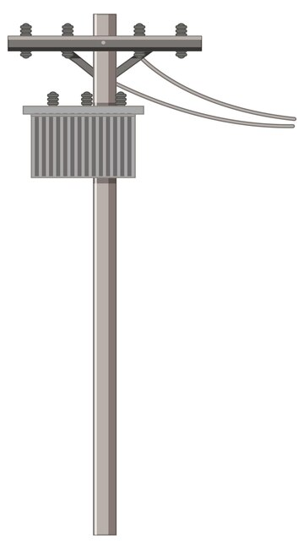
The Problem
Utility pole attachments are a perennial challenge for broadband deployment, impacting cost and construction time.
State broadband offices list these permitting processes including pole attachments as potential barriers to meeting federal funding requirements.
The approval process can take months to years in some cases.
Policymakers and broadband providers are concerned broadband projects funded by federal programs, like the $42 billion Broadband, Equity, Access, and Deployment (BEAD) program will face delays due to the utility pole attachment process.
2
The Pole Attachment Problem

Slide 3
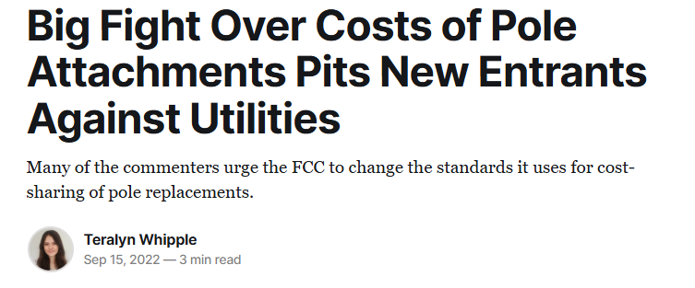
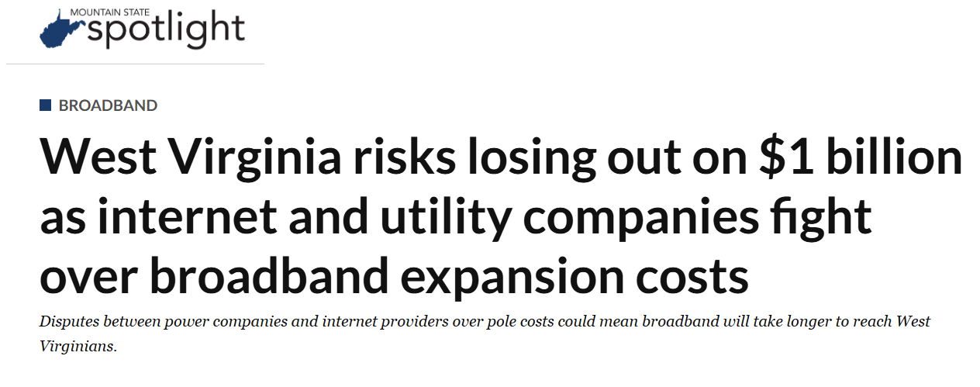
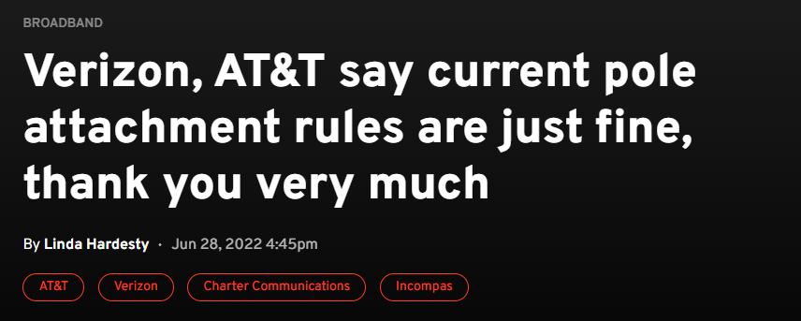
“Poles, as it turns out, seethe with operatic drama. They are creosote-soaked, 40-foot-high wooden battlegrounds.”
3
The Pole Attachment Problem

Slide 4
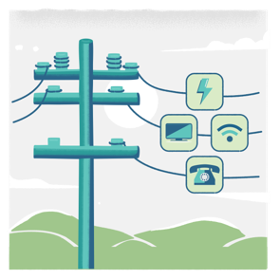
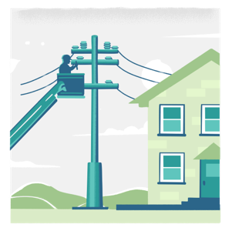
Pole Attachment Process
Application Process
Make-Ready Costs
Deployment
4
The Pole Attachment Problem

Slide 5
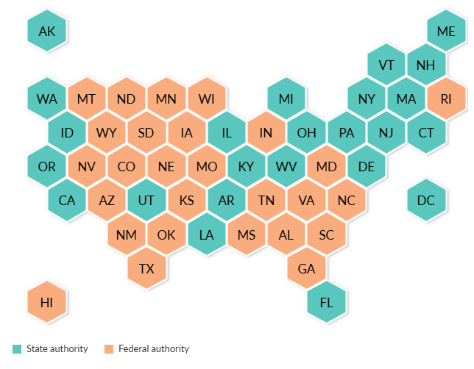
Findings and Recommendations
23 States and Washington, D.C., Manage Pole Attachments Separate From Federal Rules
Increase access to standardized data about pole assets, costs, and timelines of attachment to enable public agencies to make funding and regulatory decisions.
Create tools to digitize / streamline local permitting systems and build local capacity to handle the anticipated influx of attachment requests and related permitting applications.
Standardize and monitor pole attachment timelines, cost allocations, and other practices and create mechanisms to promptly resolve disputes.
Ensure that pole–replacement programs and disaster mitigation funds promote increased standardization and transparency of the attachment process.
States by authority over pole attachments
Source: Federal Communications Commission, States That Have Certified That They Regulate Pole Attachments, June 13, 2022
© 2025 The Pew Charitable Trust
5
The Pole Attachment Problem

Slide 6
Thank you!
Pew.org/poleattachments

