Slide 1
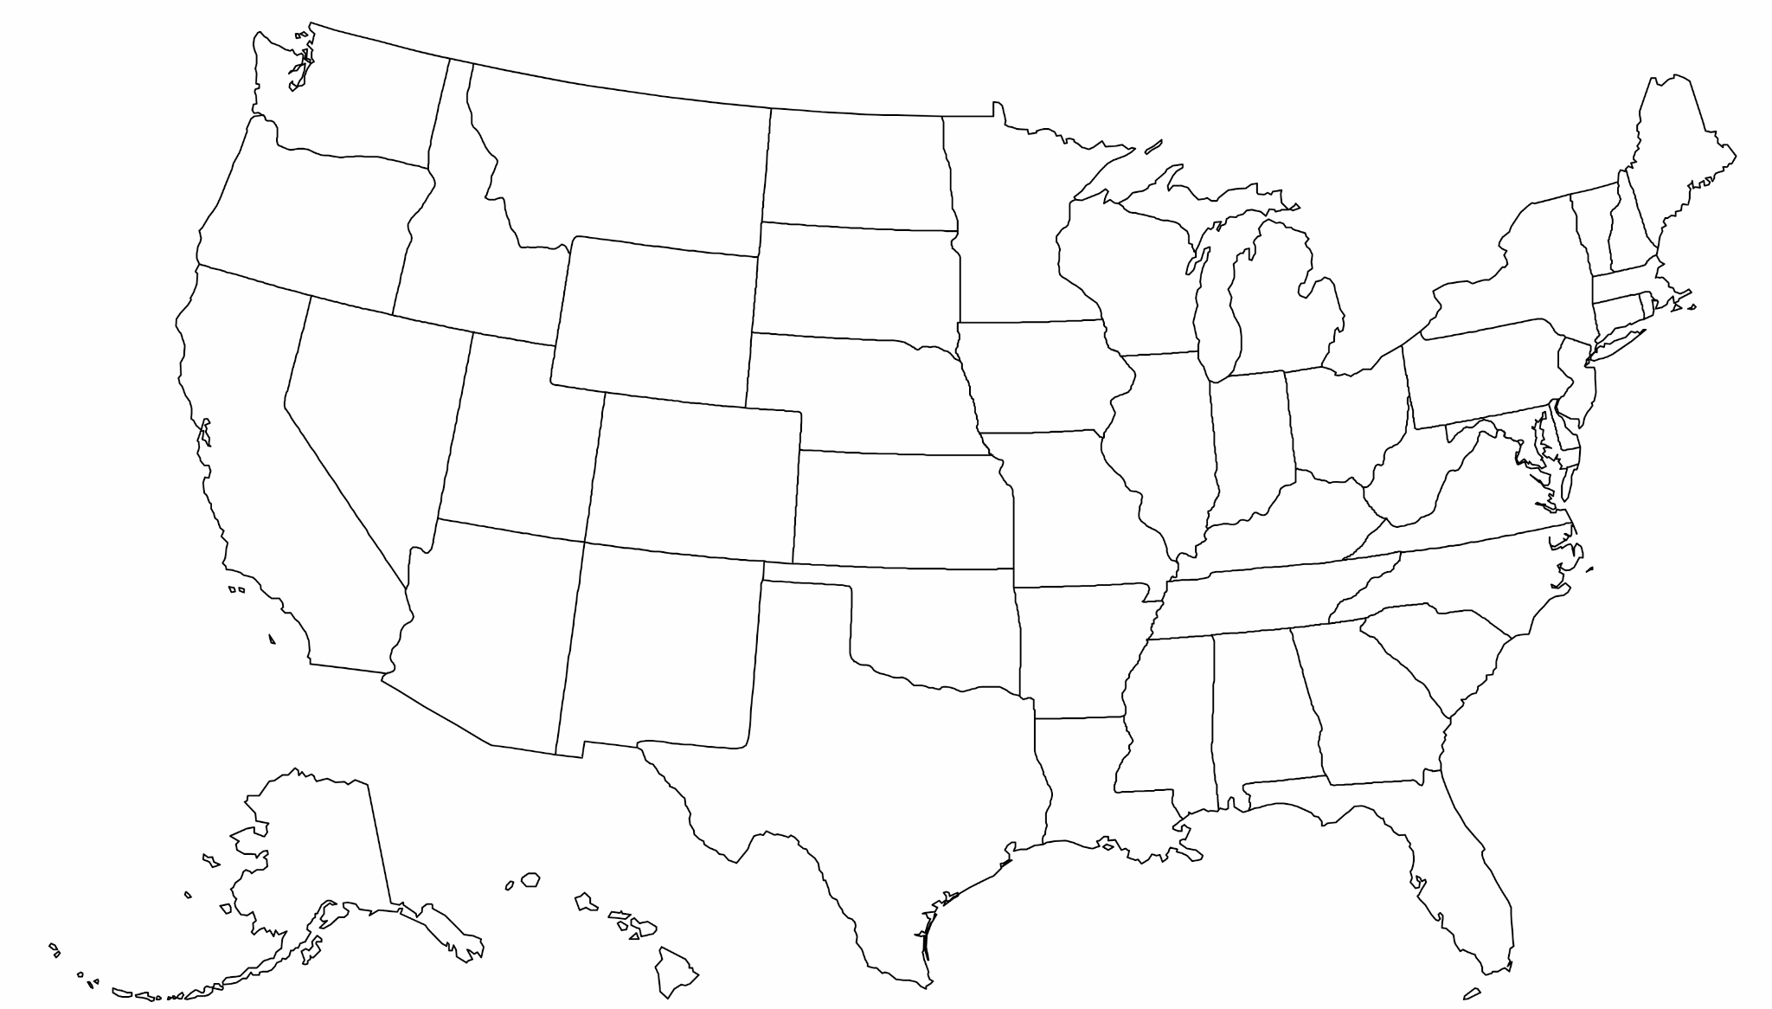
State Connections
The broadband working group for state legislators
First Friday of Every Month
4:00 ET / 3:00 CT / 2:00 MT / 1:00 PT
WE WILL BEGIN SHORTLY!

Slide 2
Agenda
Federal News — Busy Week!
Digital Equity Grants Termination
New BEAD Broadband Infrastructure Guidance
FCC loses two commissioners. Down to 1-1.
Poles Attachment Policy
Pole attachment overview (Jake Varn, Pew)
Enhancing the Pole Attachment Processes in Indiana (Sen. Andy Zay, IN-17)
Special Session on BEAD?

Slide 3
Federal News
Digital Equity Grants ($2.75b) Terminated
Grants cancelled by executive action on May 8th.
States to lose millions for devices, cybersecurity, workforce, etc.
Nonprofits and municipalities hit too.
Response
Termination likely illegal. DEA is the law
Vermont Attorney General filing lawsuit
Other states considering
States must join suit to get relief (?)
Threat of Congressional rescissions
“All Digital Equity Competitive and Digital Equity Capacity grant awards have been terminated, except for grants to Native Entities, which are pending further legal review.”
-NTIA Notice

Slide 4
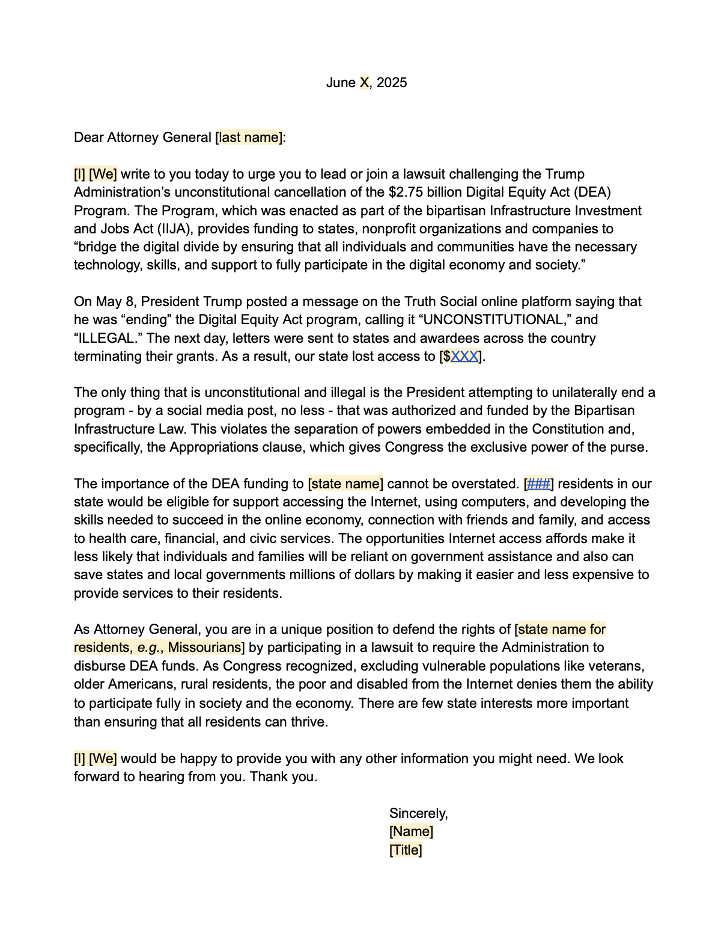
Template Letter to State AGs
Digital Equity Letter
Best Defense: Attorneys General
Consider sending letter to your attorney general
It’s likely that only states that sue will get relief
Vermont (and many others) are already moving forward.
We Can Help
Easy to use template letter
We can help you fill it in
Email: dgarner@benton.org

Slide 5
BEAD Changes = Major Disruption
Changes
Update maps
Rerun grant program
All locations available, ISPs reapply
Technology “agnostic”
States determine “priority projects”
Lowest bidder wins (within 15%)
States submit results within 90 days
NTIA respond within 90 days
Distribute money by end of year
Other changes
Affordability removed
Non-deployment/adoption tabled
“What we’ve asked all the states to do is rebid just with reasonable technology, and then we’ll get the money out the door in the calendar year 2025.”
-Sec. Lutnick
Notes:
states have 90 days to submit FP
BoB bidding round - tech neutral
Rescind all prelim and provisional award
Climate labor
Lifeline low cost
Lack of specificity on non-deployment (cant run simultaneously)
Affordability - biggest issue

Slide 6
BEAD Changes Per Evan Feinman
Former BEAD Director
The new BEAD guidance…
Rescinds prior approved final proposals for Louisiana, Nevada, and Delaware;
Doesn’t respect any of the progress made in dozens of other states, or the hundreds of millions in taxpayer and private funds already expended
Requires a new subgrantee selection round for everyone at new taxpayer expense
Requires a quasi-challenge for unlicensed fixed wireless which will be a colossal mess
Requires least cost everywhere, for all tech, which will dramatically reduce fiber and fixed wireless connections relative to satellite connections
Rescinds all non deployment awards, including workforce spending already approved in IPs and won’t reimburse for that
Requires every state submit a new IP within 30 days.
Notes:
states have 90 days to submit FP
BoB bidding round - tech neutral
Rescind all prelim and provisional award
Climate labor
Lifeline low cost

Slide 7
Federal News
FCC Loses Two Commissioners
Simington (R) and Starks (D) stepping down Friday
Carr (R) and Gomez (D) remain.
1-1 Commission doesn’t meet quorum, limiting ability to act
Nominee, Olivia Trusty (R), is awaiting confirmation in the Senate

Slide 8
Poles!
Jake Varn, Pew Broadband Access Initiative
State Senator Andy Zay, Indiana

Slide 9
Special Session on BEAD Next Week?

Slide 10
Contact Information
Janie Dunning
janiedunning@hotmail.com
(573) 289-4277
Drew Garner
dgarner@benton.org
(314) 803-7187

